Slide 1
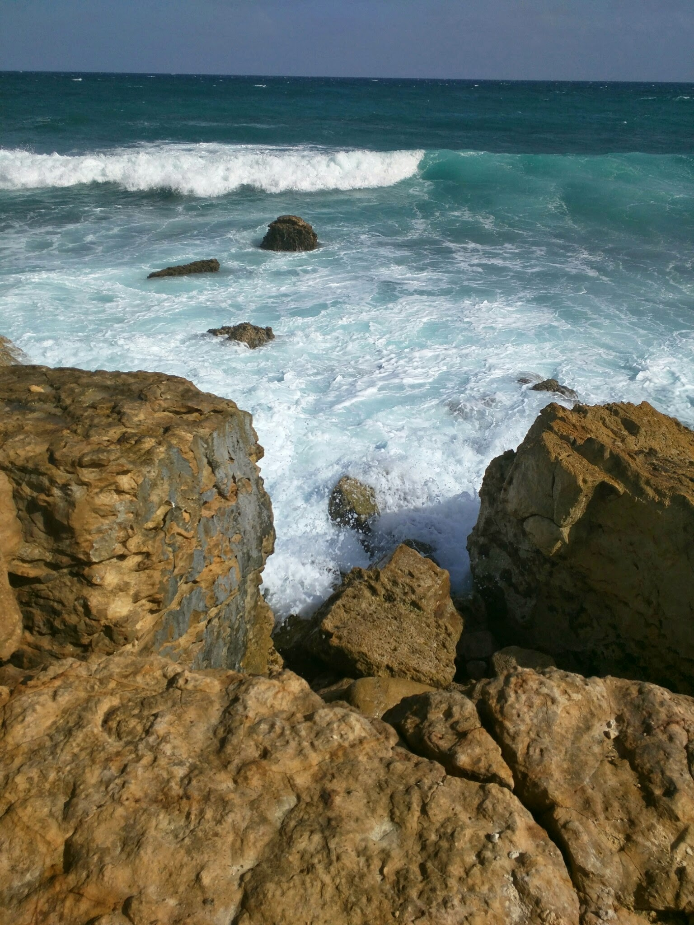
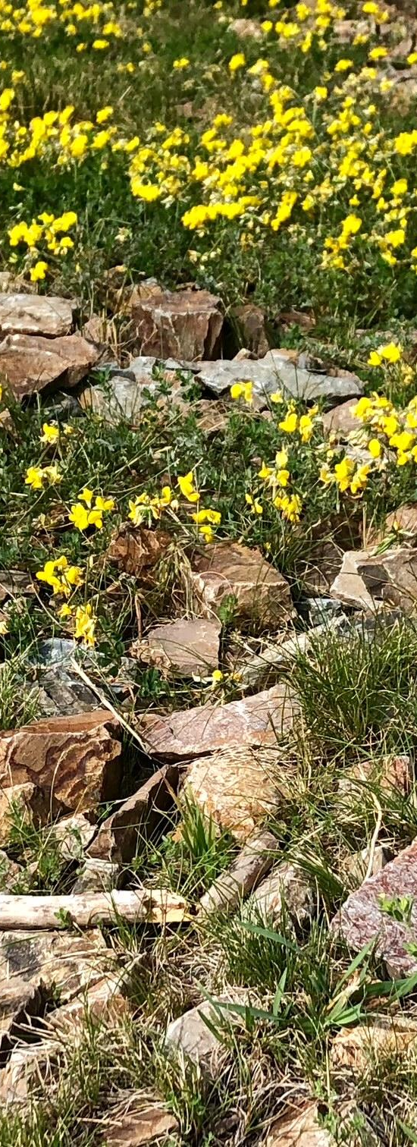
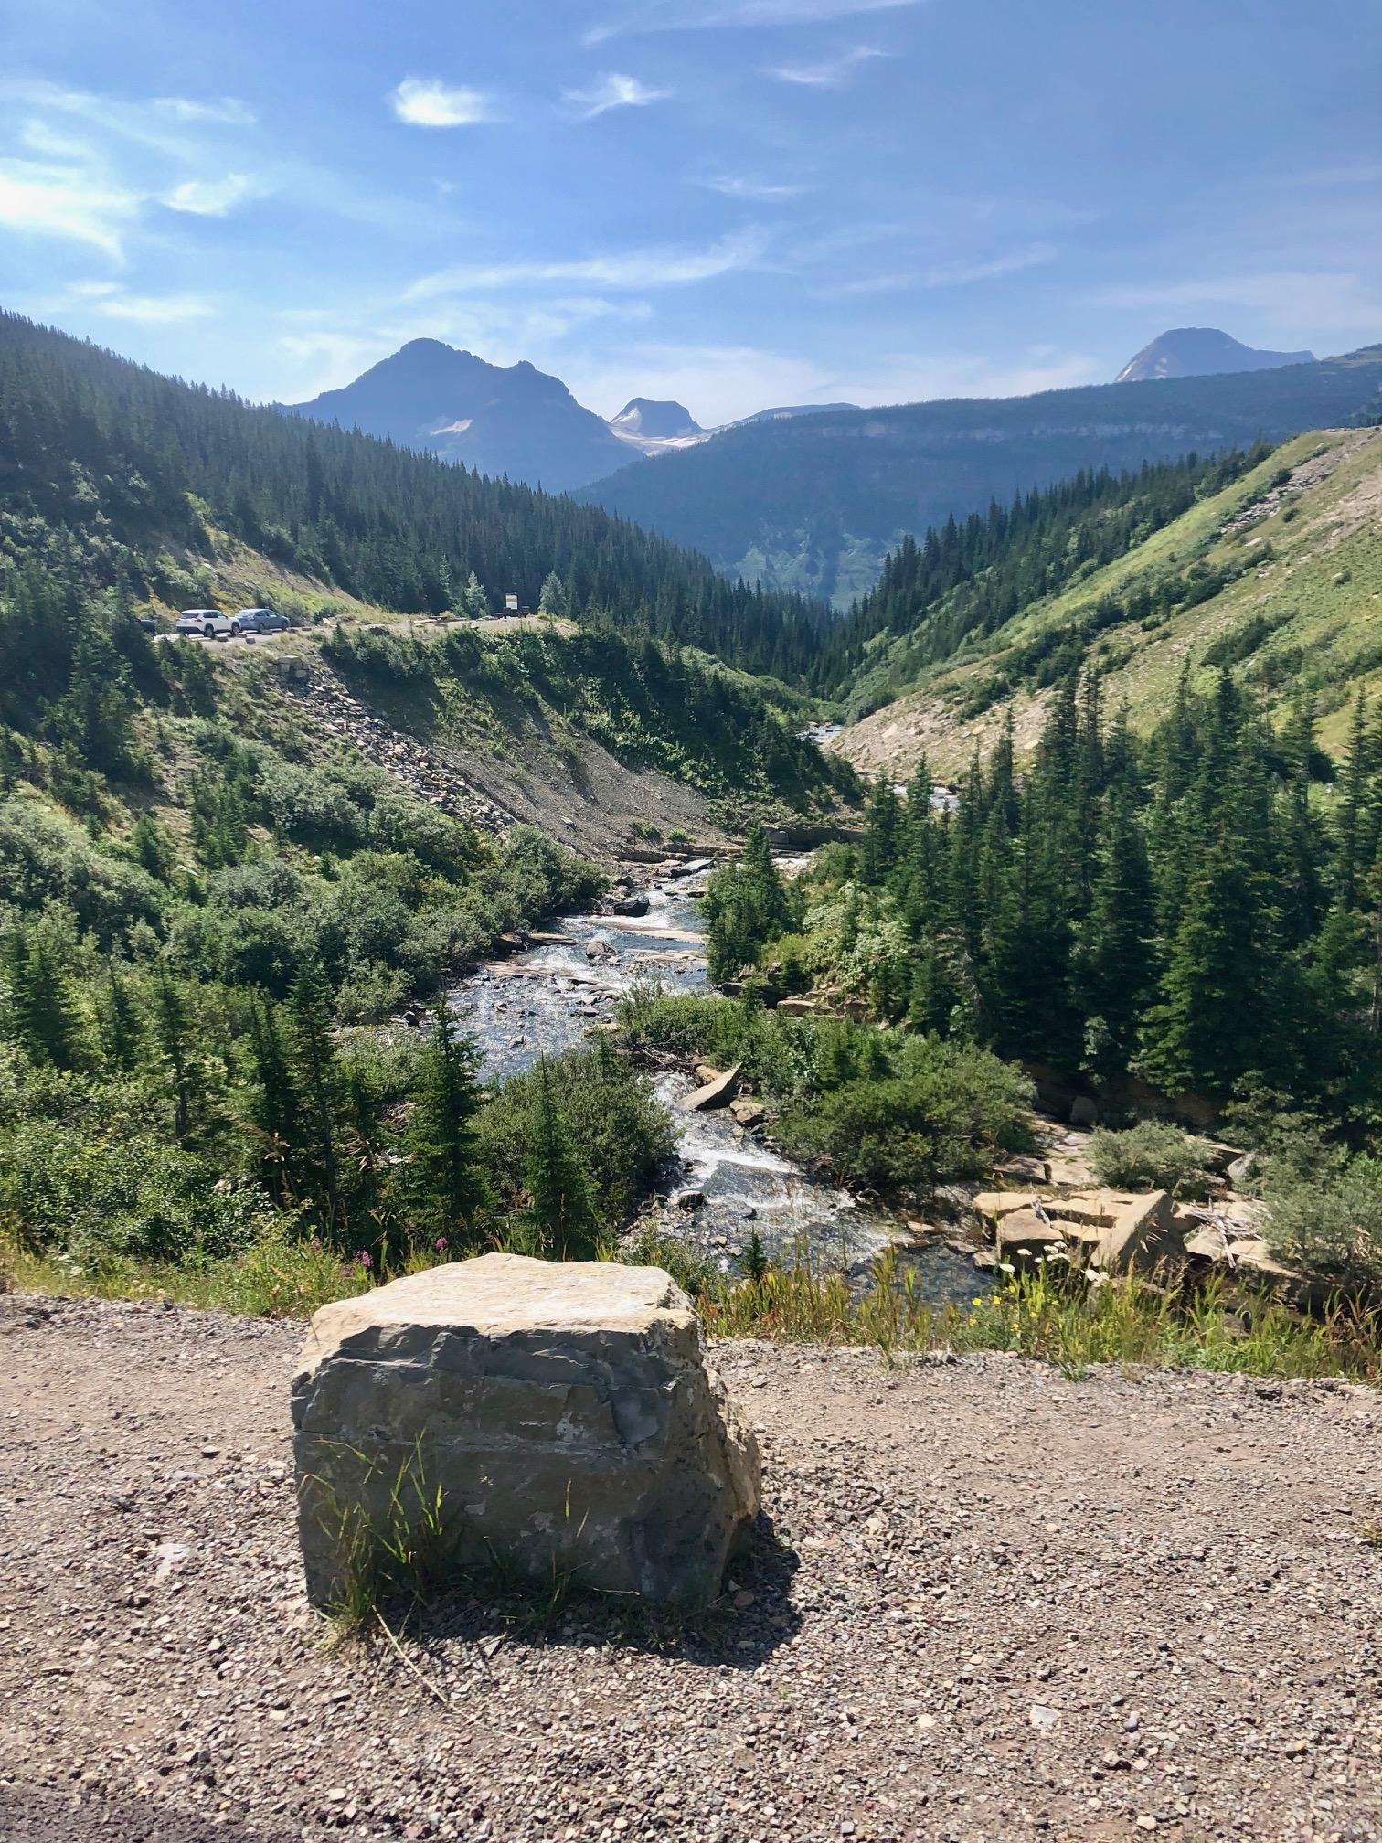
Waking Up From Autopilot: Lessons on Burnout
from a Recovering People-Pleaser
Lee-Ann O’Dell

Slide 2

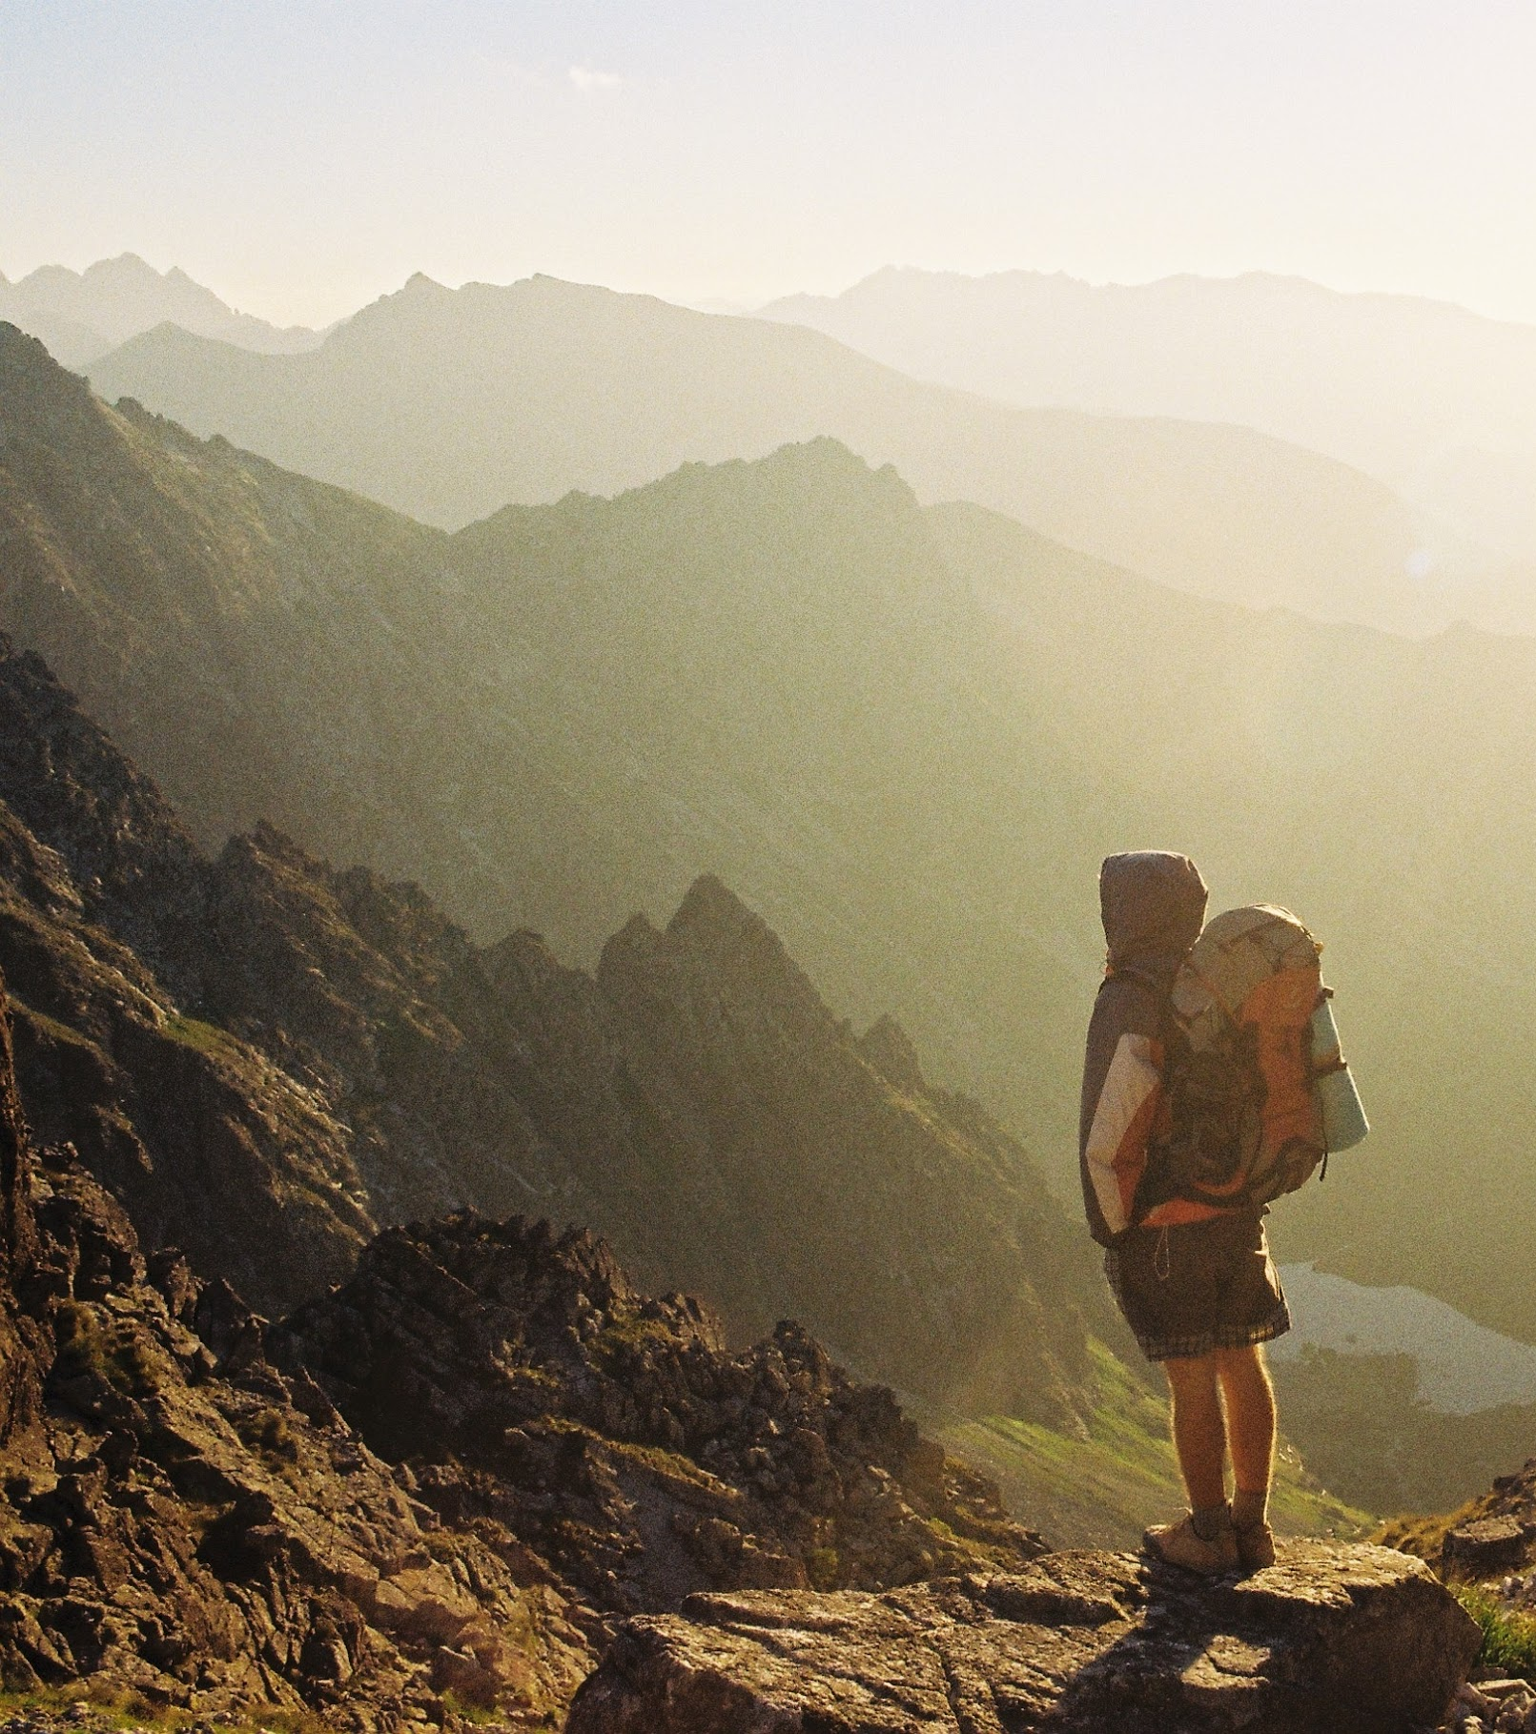

Mindset is everything
Examine your belief system. Make sure it’s actually yours.

Slide 3

Prime conditions for burnout

Slide 4

Chronic exhaustion

Slide 5
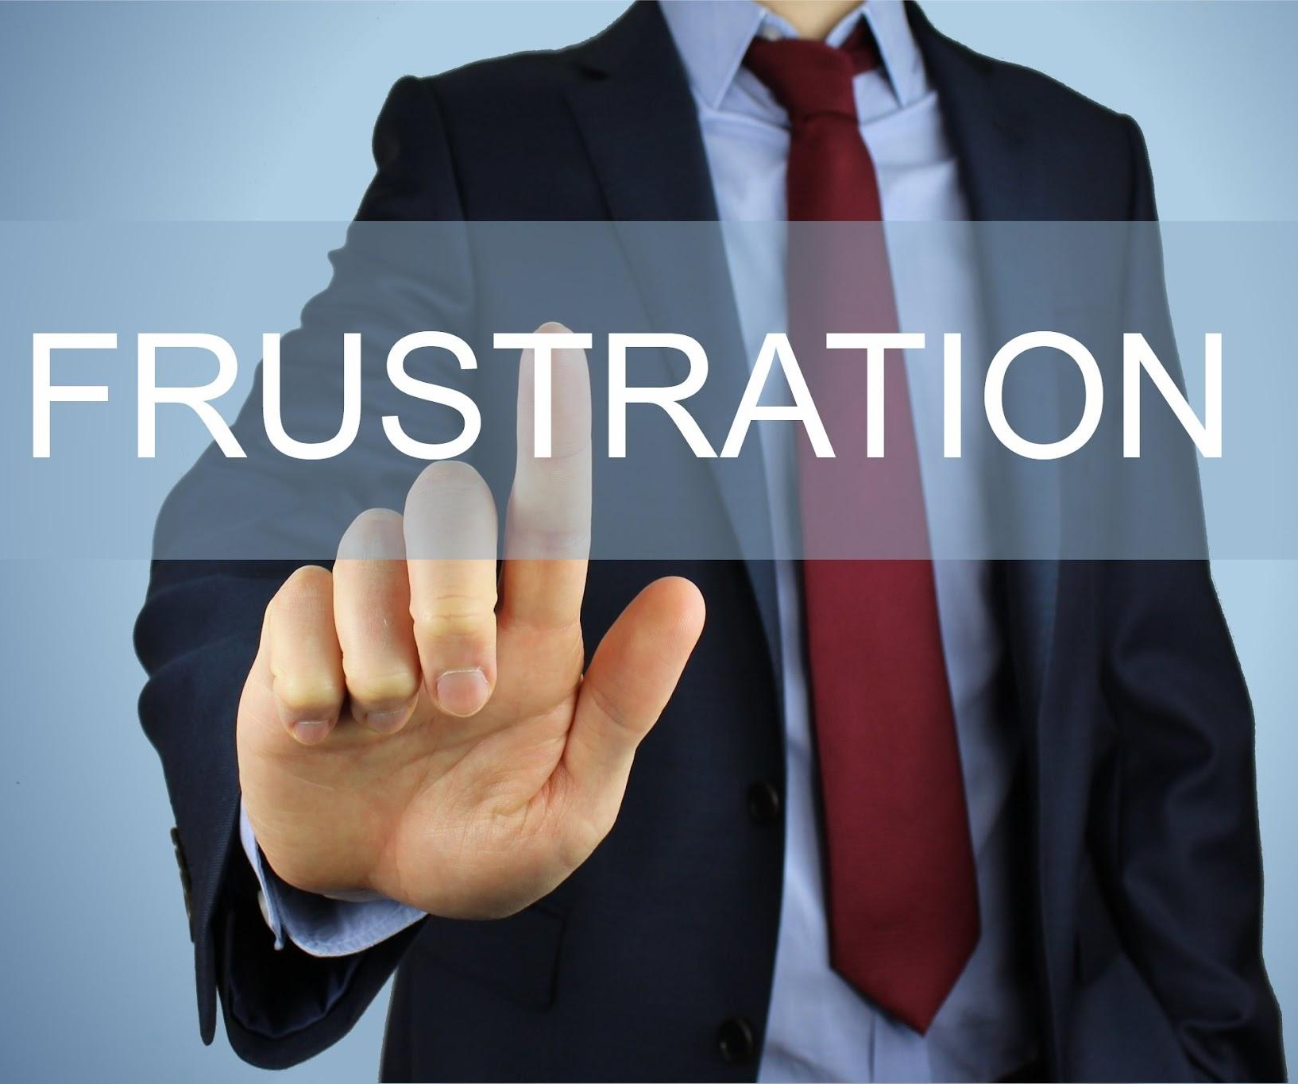
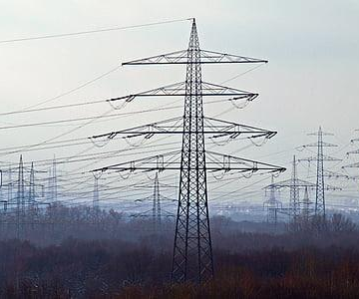

Feeling like a live wire all the time
Detached, Unmotivated

Slide 6
Symptoms of BURNOUT to look out for
Physical and mental exhaustion. Your energy is zapped.
Depersonalization - a feeling of indifference, numbness, cynical
Reduced personal accomplishment (efficacy) and/or performance - losing pleasure in your work, lack of focus
Integris Health

Slide 7
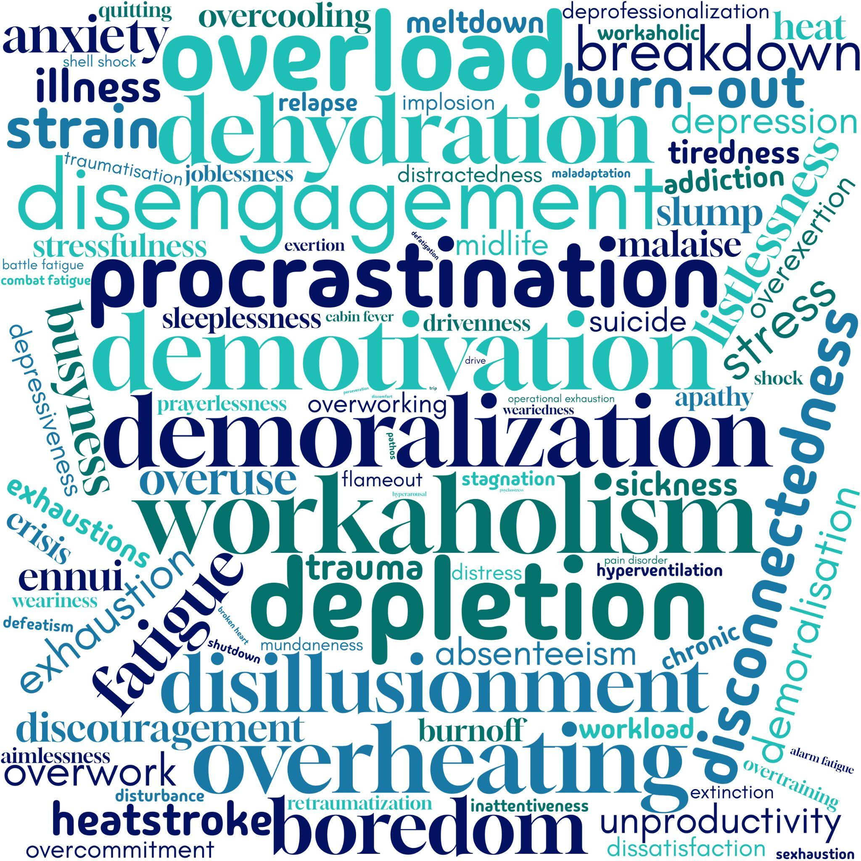
“Powering through” isn’t an option

Slide 8
Health consequences of chronic stress

Slide 9
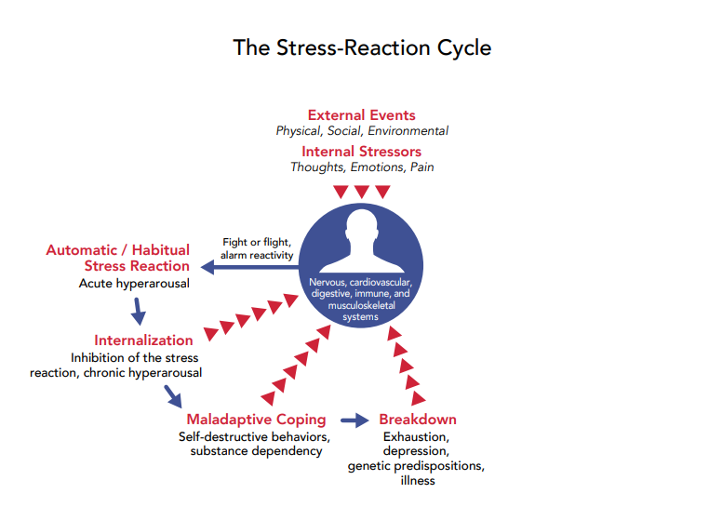
Mindfulness
Mediated Stress Response
DEEP BREATHING
YOGA
MEDITATION, CREATING
ACTIVATES PARASYMPATHETIC NS

Slide 10
Autoimmune diseases occur when the body's immune system mistakenly attacks its own healthy tissues and organs. Here is a list of some common autoimmune diseases:
Endocrine System: Addison's disease, Graves' disease, Hashimoto's thyroiditis, and Type 1 diabetes.
Musculoskeletal System: Rheumatoid arthritis, Psoriatic arthritis, Lupus, and Myasthenia gravis.
Gastrointestinal System: Crohn's disease, Ulcerative colitis, and Celiac disease.
Skin and Connective Tissue: Scleroderma, Vasculitis, Psoriasis, and Systemic lupus erythematosus (lupus).
Neurological System: Multiple sclerosis, Guillain-Barré syndrome, Myasthenia gravis, and Sjögren's syndrome.
Other: Pernicious anemia, Reactive arthritis, Autoimmune hemolytic anemia, and Idiopathic thrombocytopenic purpura (ITP).
This is not an exhaustive list.

Slide 11
Burnout costs employers in real dollars

Slide 12
According to the Harvard Business Review, U.S. businesses lose between $125 billion to $190 billion annually in healthcare costs due to workplace burnout. Additionally, burnout can lead to a 50% increase in safety incidents and a 37% increase in absenteeism, which further elevates operational costs.
May 16, 2024
Source: https://tryhealium.com/blog/cost-of-burnout-and-turnover

Slide 13
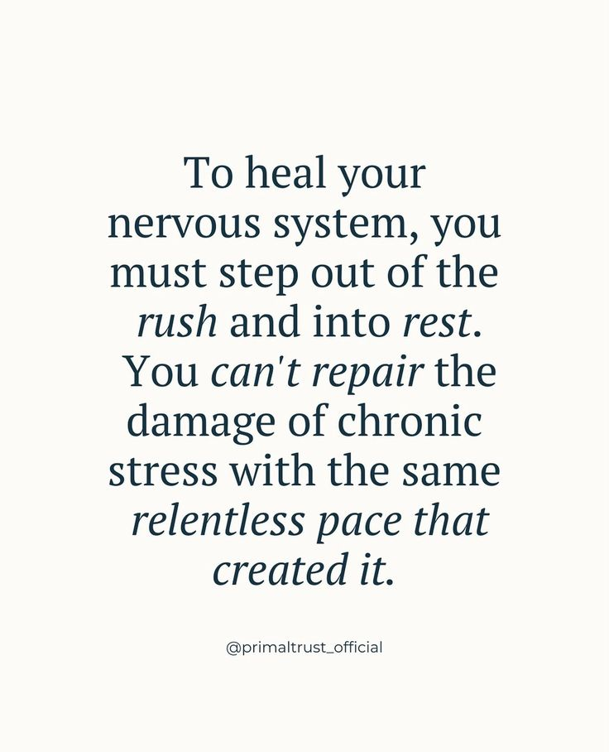
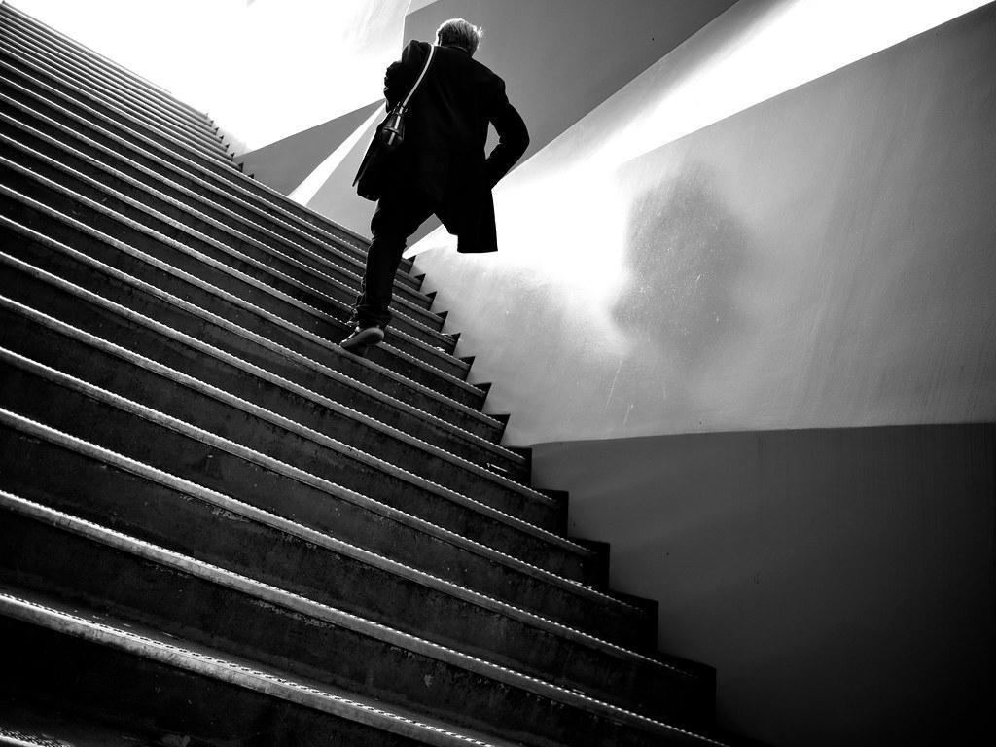
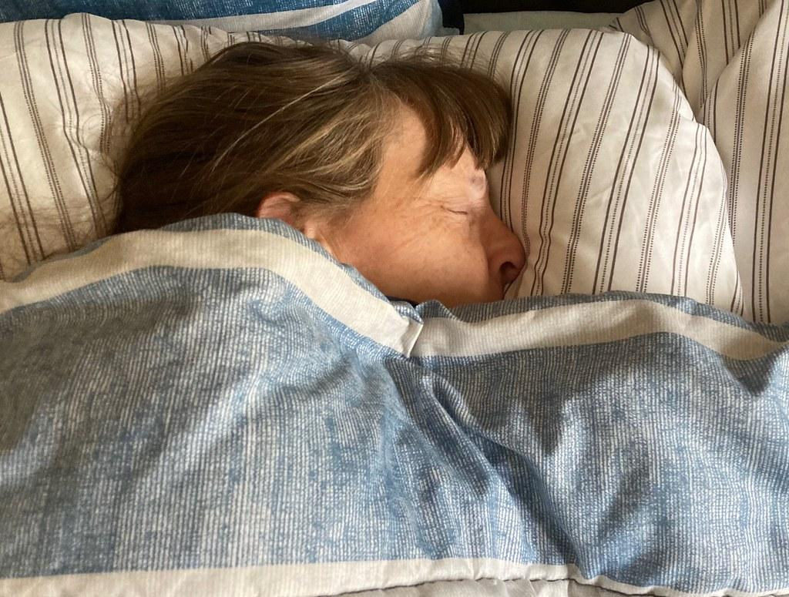
Healing takes time and requires a change in mindset

Slide 14


Slide 15
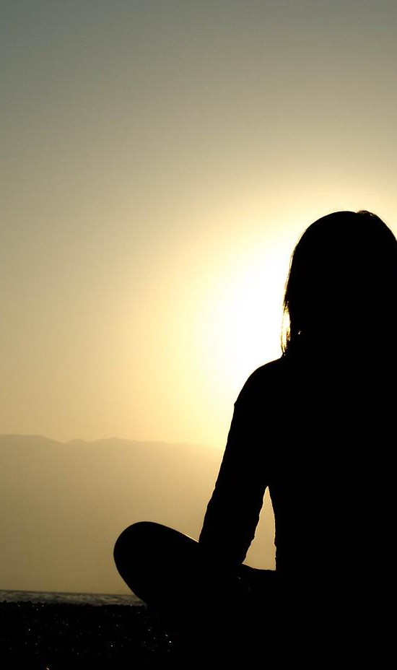


Slide 16

REST
CLARITY - NEW MINDSET
NEW HABITS
GROWTH

Slide 17
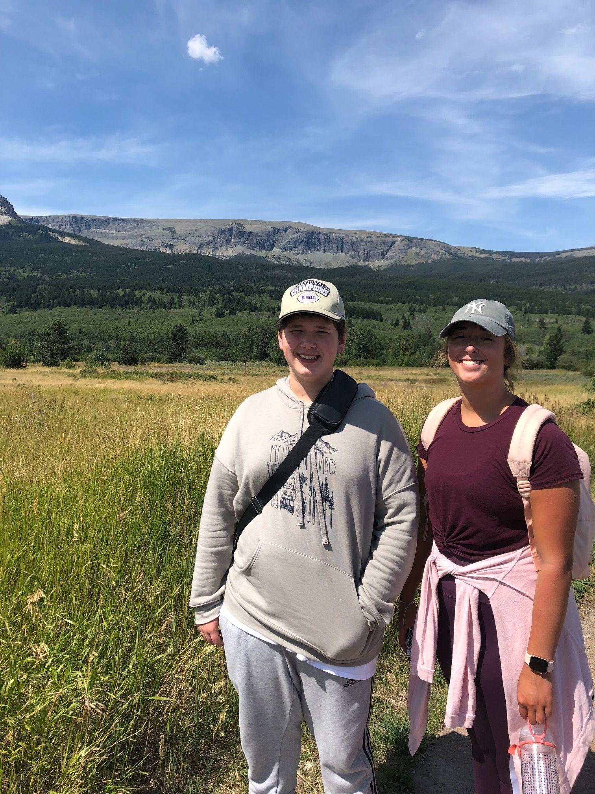
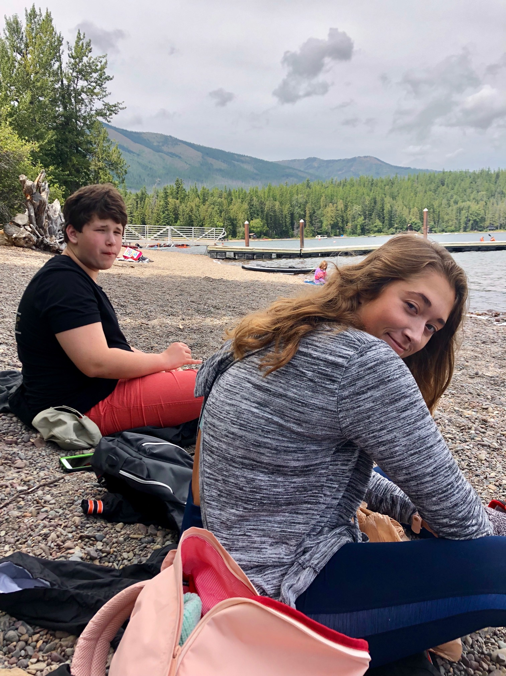
Glacier National Park, August 2019

Slide 18
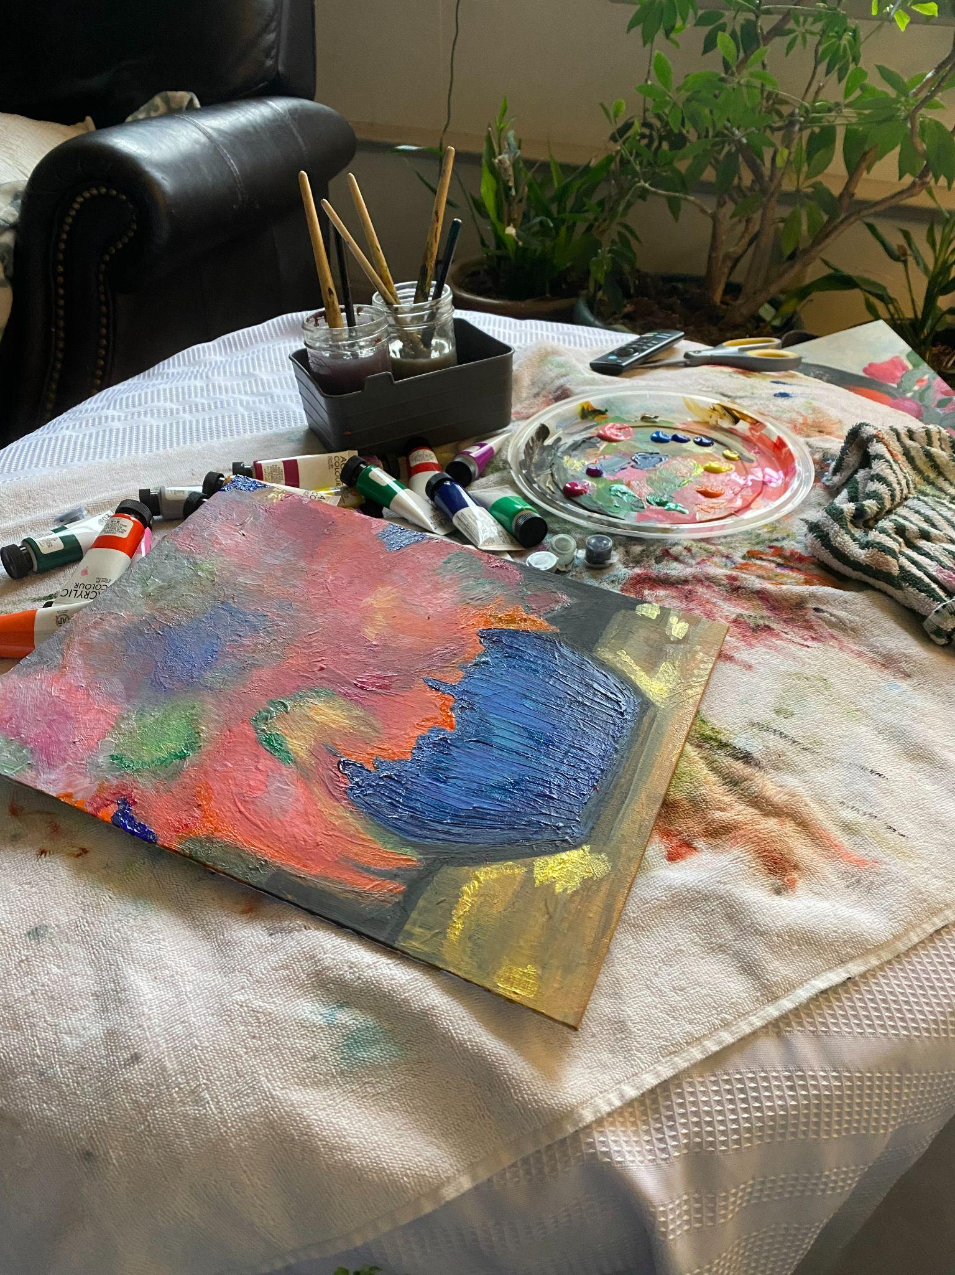

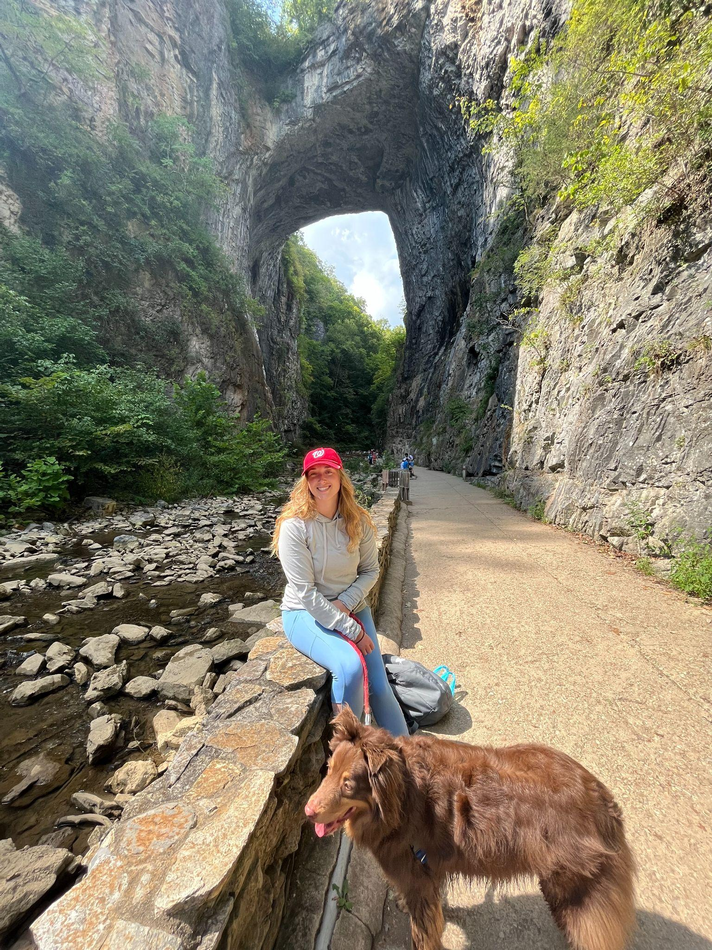

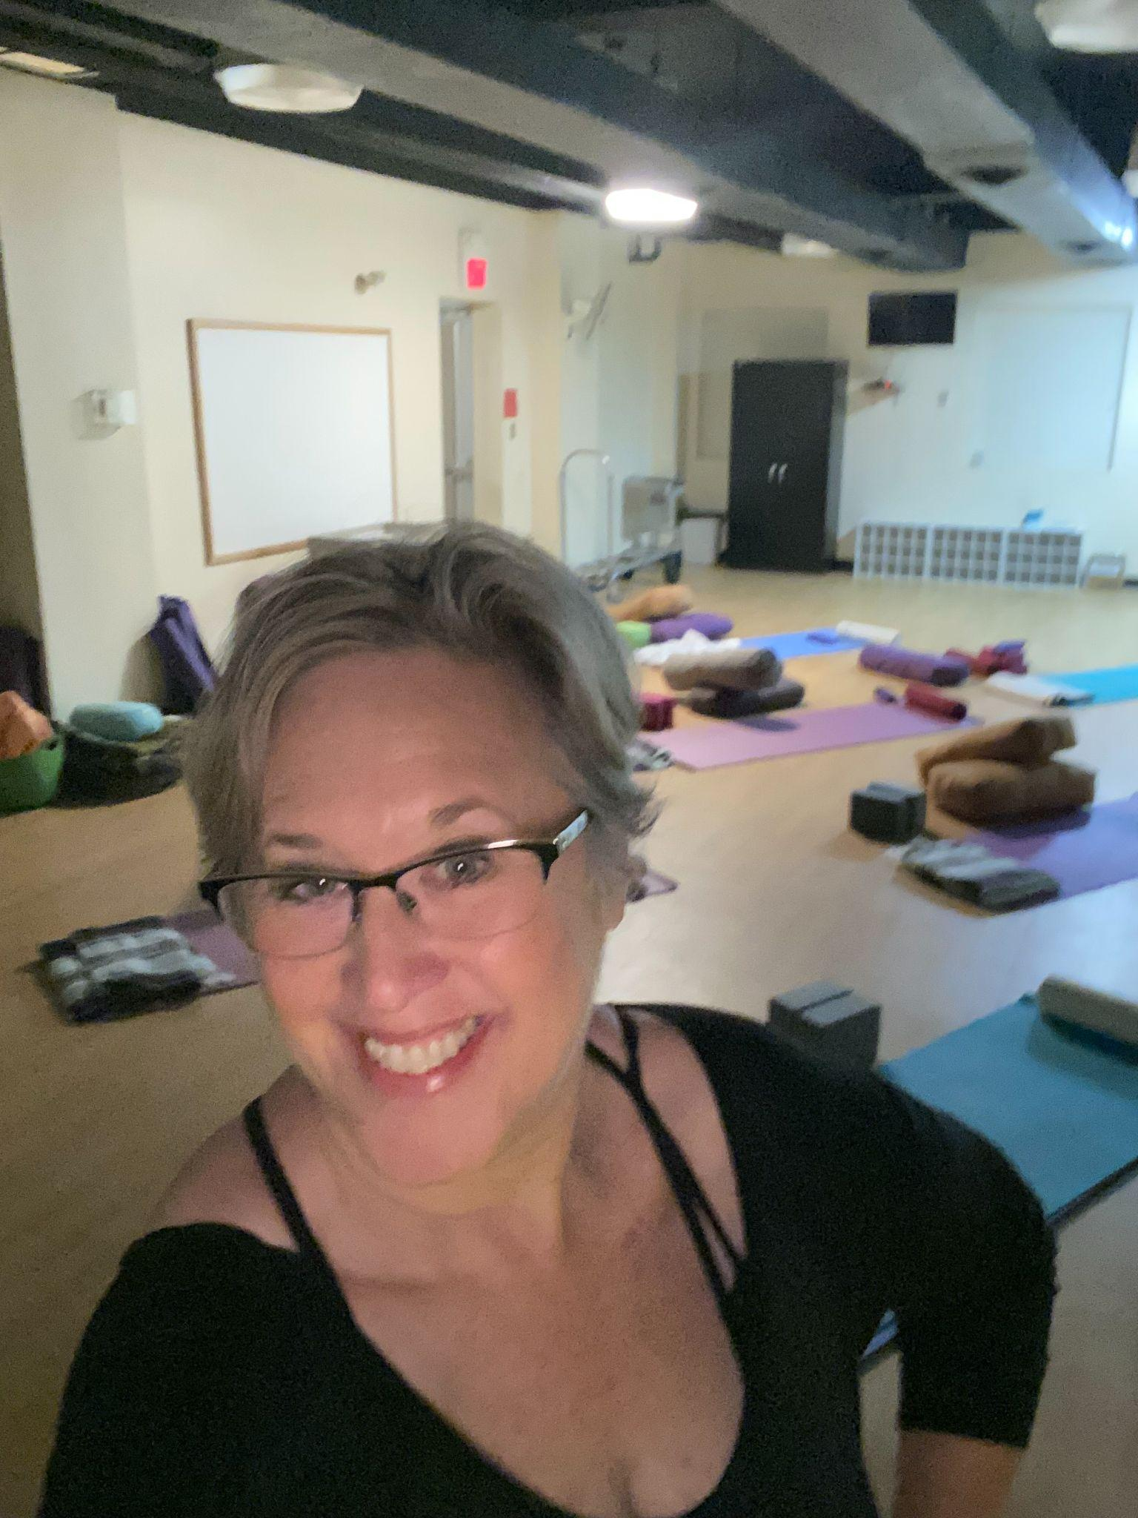

A New Life

Slide 19
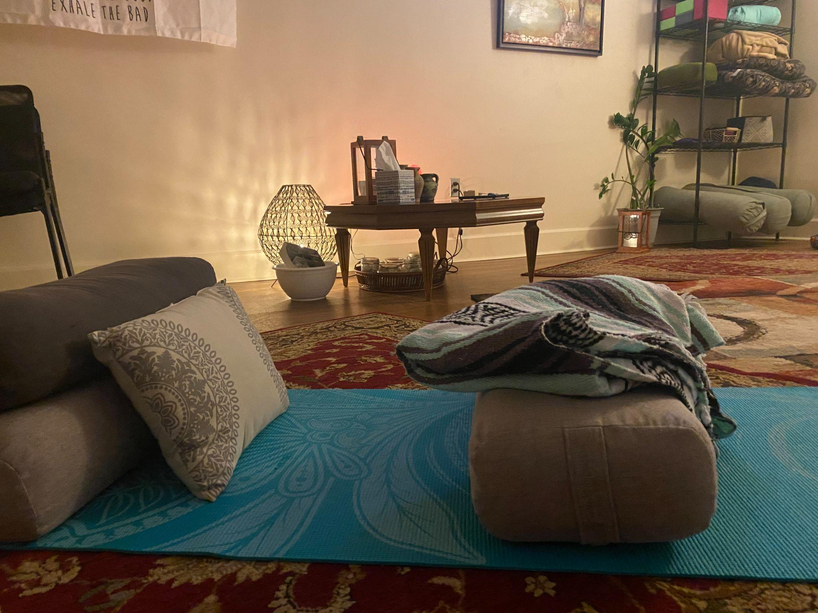
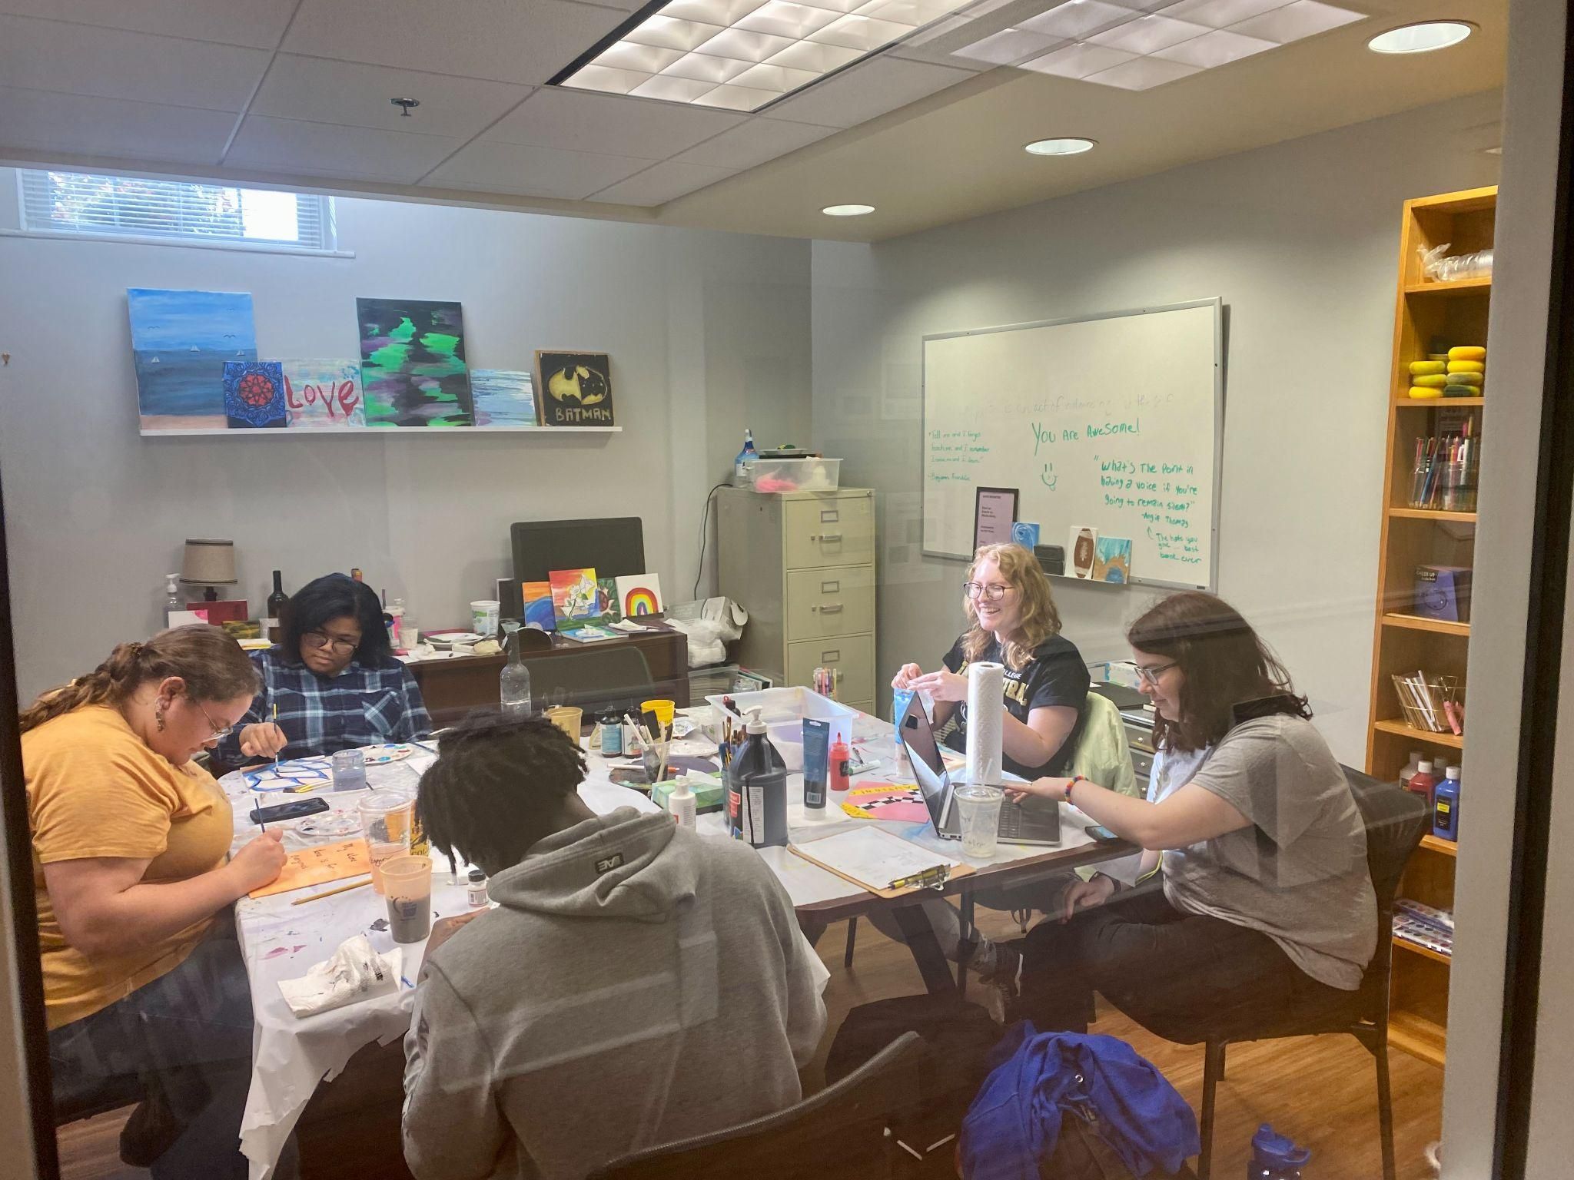
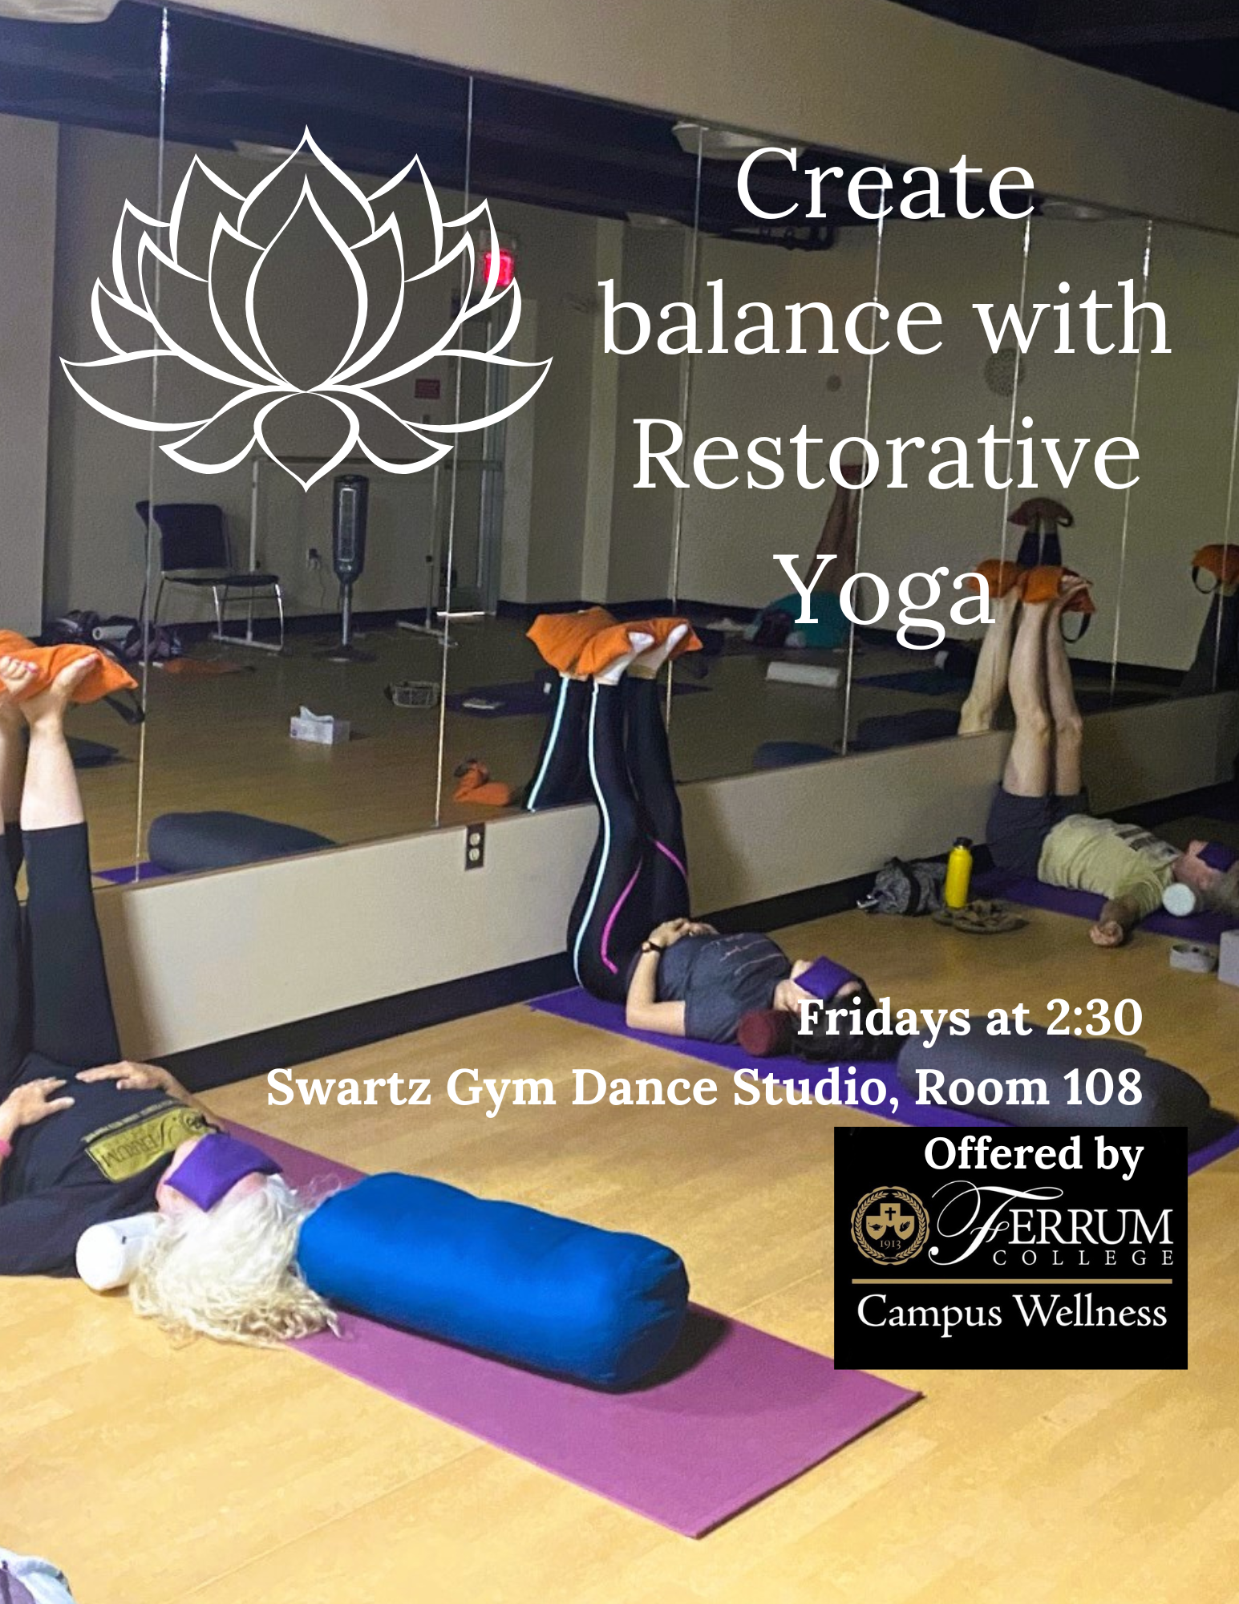
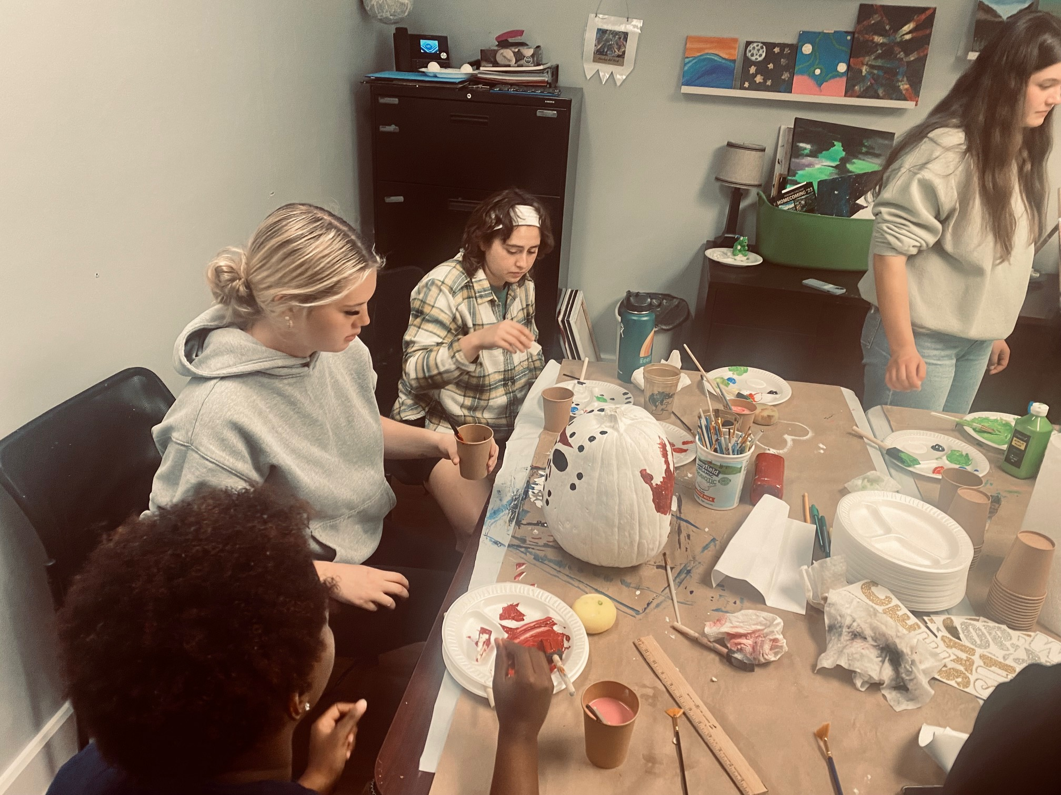
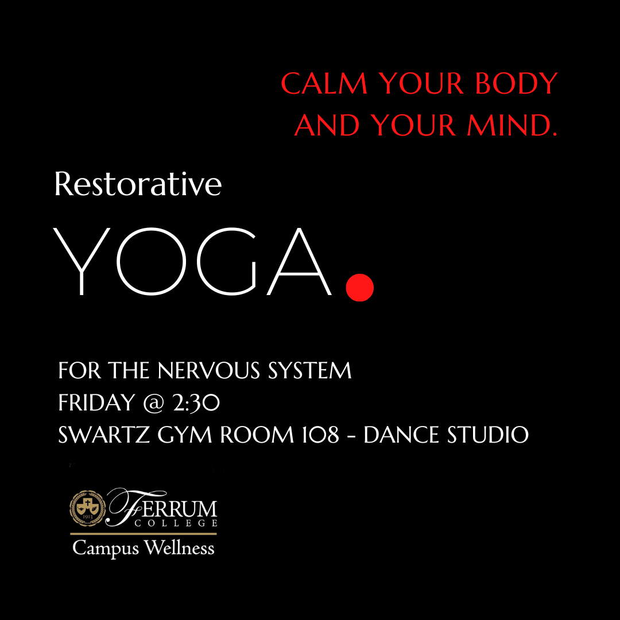
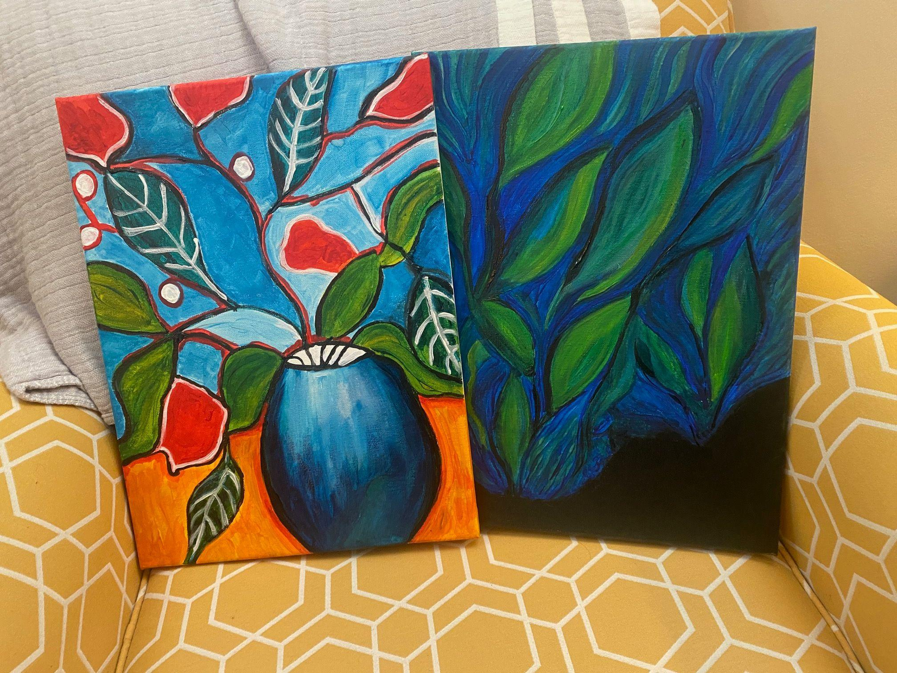
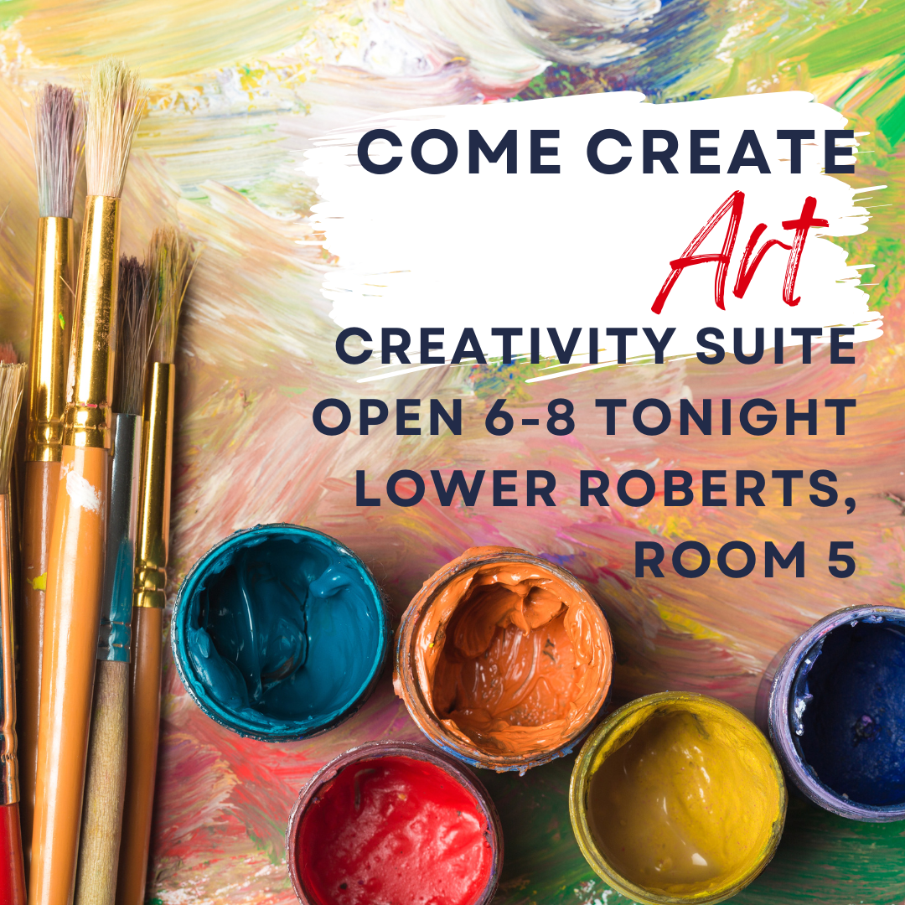
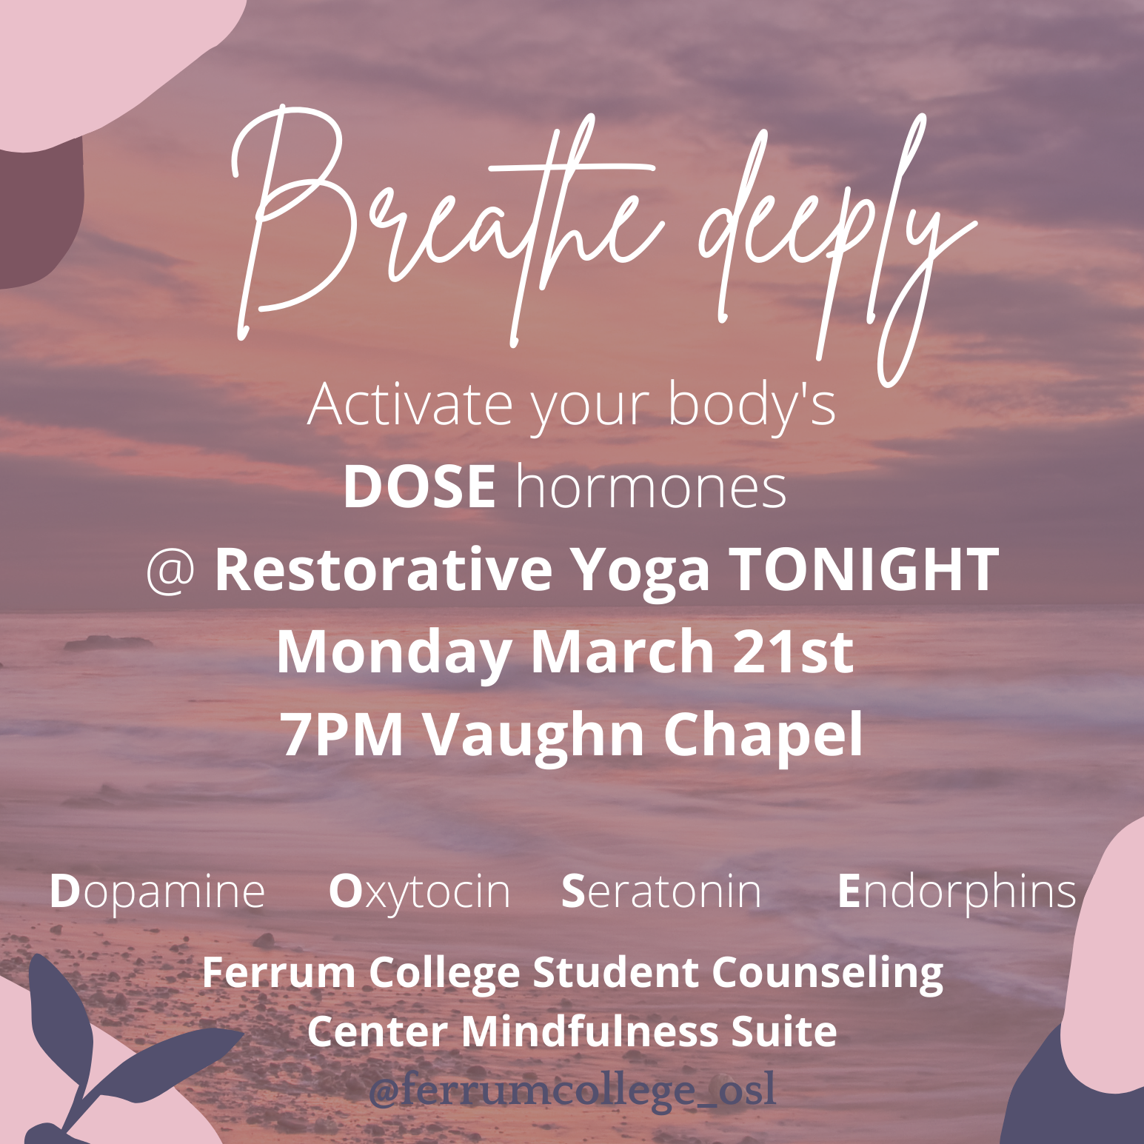
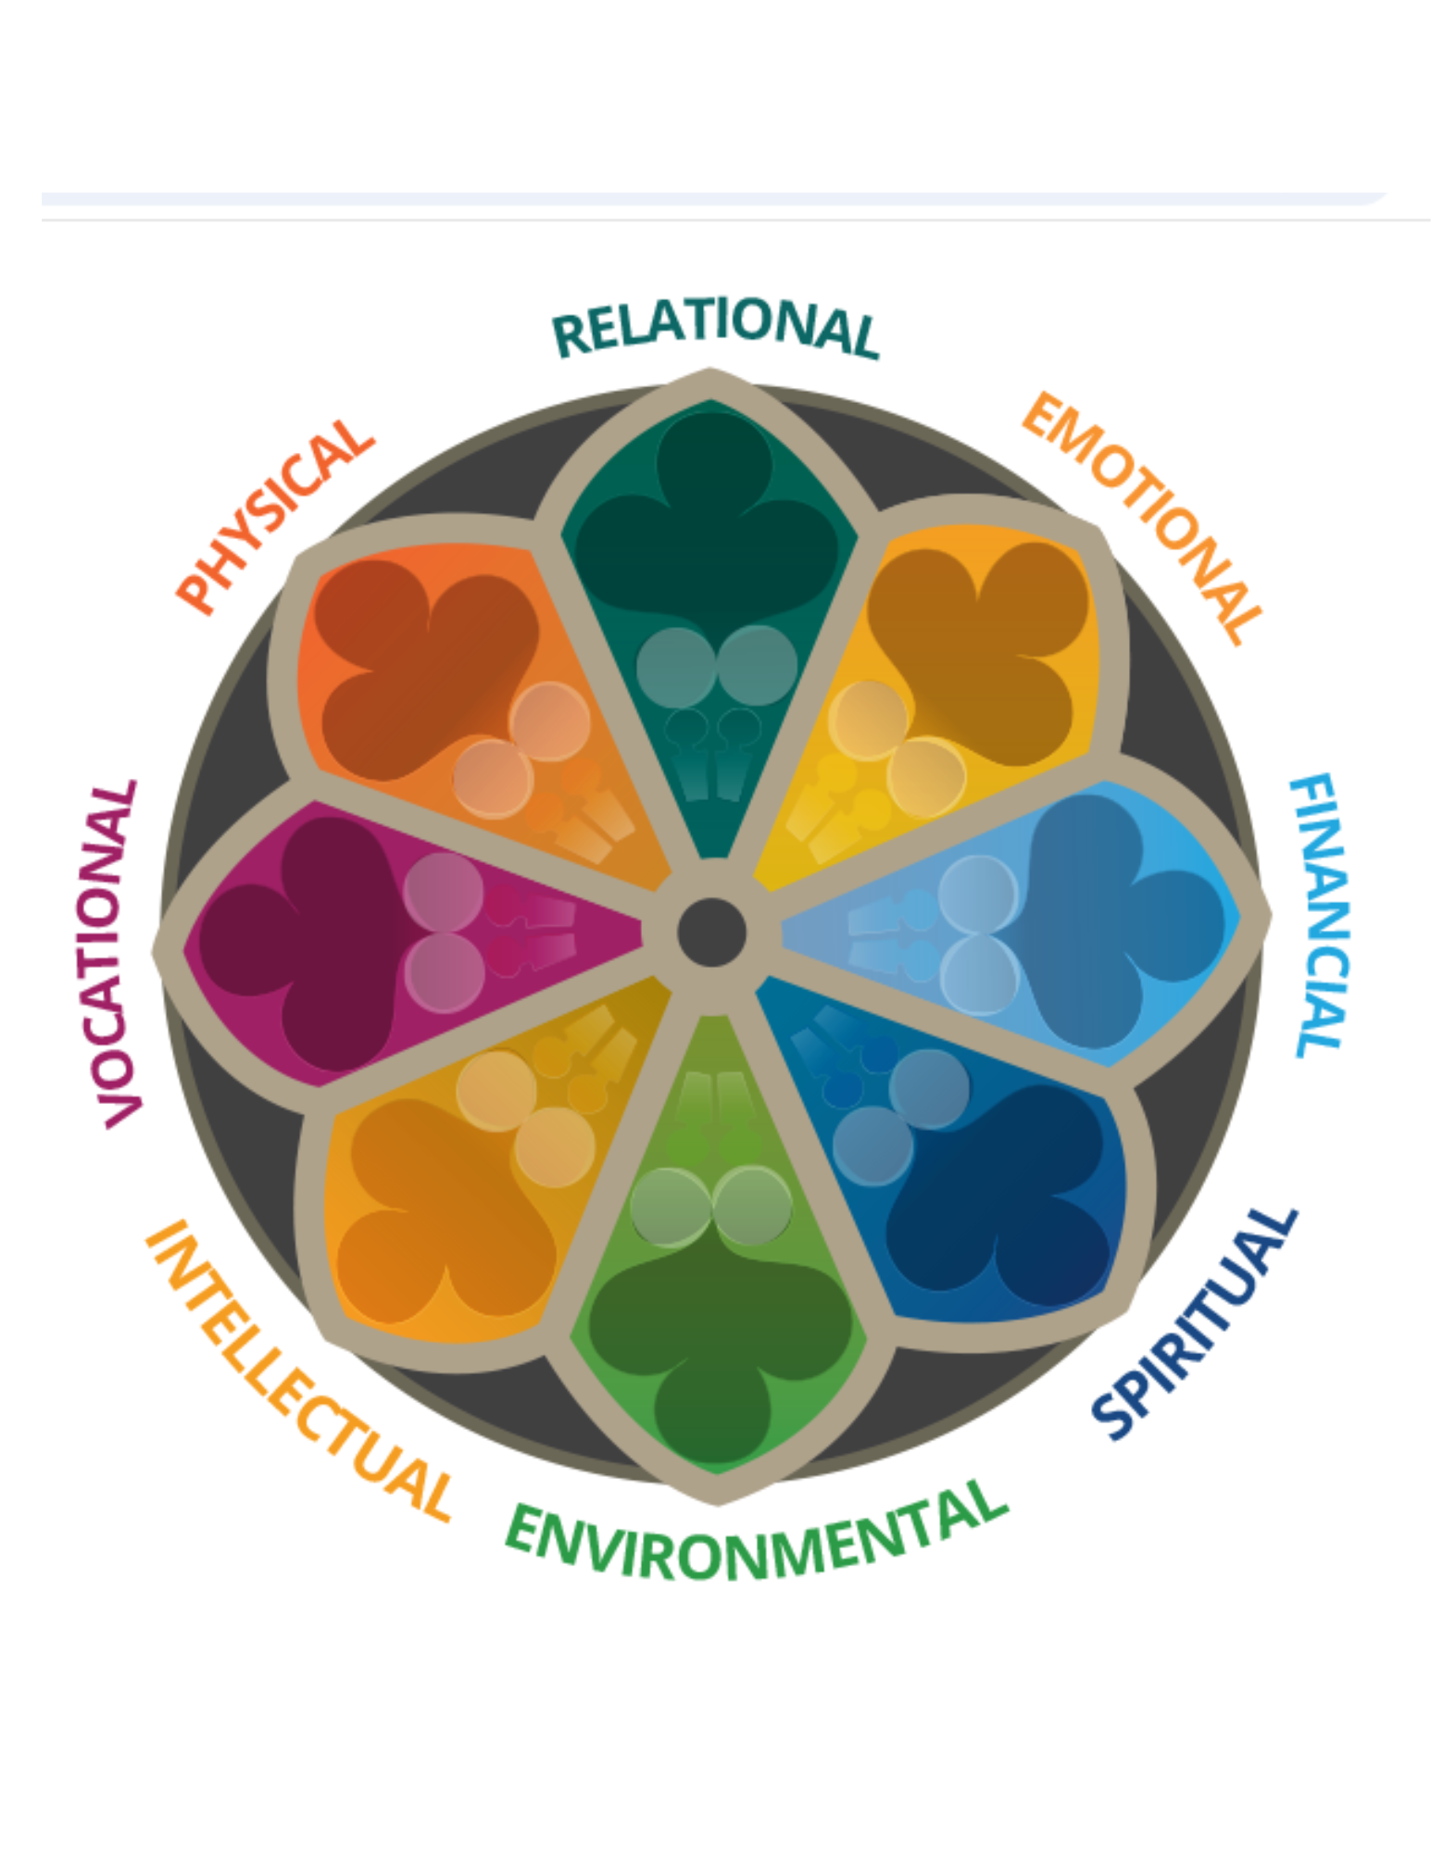
New work with passion and purpose

