Slide 1
Data Privacy in Higher Education: CICV June Conference Talking Points
Higher education institutions face growing challenges in protecting sensitive information in today's technology-driven world. The reliance on digital tools for teaching, research, and administration requires managing vast amounts of data, such as student records, financial information, and intellectual property. Weak data privacy policies heighten the risks of cyberattacks, regulatory noncompliance, and reputational damage.
Matt McKenna
June 2025
Notes:
Welcome everyone to today’s session. Data privacy is a growing concern across industries, and higher education is no exception. Today, we’ll discuss the challenges institutions face and strategies for safeguarding sensitive information.
For instance, consider a university conducting groundbreaking research on renewable energy. Without strong data privacy measures, a cyberattack could result in the theft of proprietary research, allowing competitors to replicate years of work and depriving the university of patent opportunities and funding. Such incidents underscore the importance of robust data privacy to safeguard institutional assets and maintain trust.

Slide 2

Problem Statement
45%
70%
Outdated Systems
Increased Attacks
Of all observed universities had at least one asset running a version of PHP past its end-of-life date
Cyberattacks in higher education increased by this percentage in 2024 compared to 2023
$4.02M
Recovery Costs
Average cost for institutions to recover from a ransomware attack
Amongst the top 500 universities, an average of 30 domains were using end-of-life PHP, indicating software that had not been updated in at least two years. These statistics highlight the urgent need for improved data privacy and security measures across higher education institutions.
Notes:
Higher education institutions manage a wealth of sensitive information.
Weak data privacy policies can lead to cyberattacks, legal issues, and reputational harm. This session aims to address these issues.
Cyberattacks are on the rise, with outdated systems amplifying vulnerabilities. The costs are steep, both financially and reputationally.
Legacy Systems: Older IT systems may lack robust security features, making them vulnerable to attacks. •
Shadow IT: Unregulated use of third-party applications by staff or students can expose sensitive data
Phishing and Social Engineering: Universities are frequent targets for cybercriminals due to the diversity of users and valuable data
Data Over-collection: Collecting more data than necessary increases the institution's risk exposure without clear benefits.

Slide 3






Unifying Themes
Identification of assets
Understanding risk
Inventory of physical, software, user accounts and entitlement processes
Specific to your organization; academia, student data, PII, lack of Information Security Standards, DR, IR, etc.
Rightsizing administrative access
Crown Jewels: "What and Where are they?"
Ensuring users have only the access necessary for their roles
Identifying your most valuable and sensitive data assets
The Blast Radius
Incident Response Planning
Limiting the impact of breaches by compartmentalizing data and access
Preparing for security incidents before they occur
Notes:
These themes provide a roadmap for improving data privacy by addressing critical areas like asset management and risk assessment.

Slide 4






Importance of Data Privacy Standards
Trust and Reputation
Ensuring data privacy builds trust with students, faculty, and stakeholders
Compliance Requirements
Adherence to regulations such as FERPA, GDPR, CCPA, and HIPAA
Operational Integrity
Protection against disruptions caused by data breaches or misuse
Strong data privacy standards are essential for higher education institutions to maintain their reputation, comply with legal requirements, and ensure smooth operations. By prioritizing these standards, universities can protect their most valuable assets while building trust with their communities.
Notes:
Strong data privacy standards build trust, ensure compliance, and protect operational integrity. Highlight the frameworks institutions can adopt.

Slide 5












Common Pitfalls and Concerns in Higher Education Data Privacy
Insufficient Awareness
Overprivileged Access
Leadership and staff may lack understanding of evolving threats
Excessive administrative rights increase breach risks
Data Over-collection
Legacy Systems
Collecting more data than necessary increases risk exposure
Older IT systems may lack robust security features
Phishing and Social Engineering
Shadow IT
Unregulated use of third-party applications exposing sensitive data
Universities are frequent targets for cybercriminals
Notes:
These pitfalls make higher education institutions especially vulnerable. Addressing them is key to strengthening data privacy.
notes around types of systems that are likely to be attacked or compromised and how data privacy plays in to them

Slide 6







Strategic Considerations for Leadership
Data Minimization
Only collect and retain data essential for institutional operations and compliance
Data Classification
Leverage data labeling and data hygiene to reduce over-exposing classified or non-public information
Role-based Access
Implement role-based access controls (RBAC) to ensure staff only access data necessary for their roles
Comprehensive Training
Regularly educate staff, faculty, and students on data privacy policies and recognize phishing or social engineering tactics
Vendor Risk Management
Assess third-party tools and platforms for compliance with data privacy standards before adoption
Incident Response Plan
Develop and regularly test a data breach response plan to minimize the impact of potential incidents
Data Lifecycle Management
Establish clear policies for data collection, storage, sharing, and disposal
Leadership should also emphasize data governance frameworks (e.g., NIST Privacy Framework, ISO 27701), ensure Board-level involvement, and implement metrics to measure the effectiveness of privacy initiatives.
Notes:
Leaders play a critical role in implementing data privacy strategies. Emphasize data governance frameworks and board-level engagement.
Data Minimization: Only collect and retain data essential for institutional operations and compliance
Data Classification: Leverage data labeling and data hygiene to reduce over-exposing classified or non-public information
Role-based Access: Implement role-based access controls (RBAC) to ensure staff only access data necessary for their roles
Comprehensive Training: Regularly educate staff, faculty, and students on data privacy policies and recognize phishing or social engineering tactics.
Vendor Risk Management: Assess third-party tools and platforms for compliance with data privacy standards before adoption.
Incident Response Plan: Develop and regularly test a data breach response plan to minimize the impact of potential incidents.
Data Lifecycle Management: Establish clear policies for data collection, storage, sharing, and disposal.
Place an emphasis on data governance frameworks (e.g., NIST Privacy Framework, ISO 27701).
Board-level involvement—leadership engagement at the highest level is critical
Emphasize metrics: How leadership can measure the effectiveness of privacy initiatives.

Slide 7






Key Actions for Administrators
Immediate (30 days): Policy Development
Ensure clear, enforceable data privacy policies are in place and updated regularly
Immediate (30 days): Auditing and Monitoring
Conduct routine audits of data access and usage logs to identify potential risks or violations
Medium-term (90 days): Encryption Standards
Use encryption for sensitive data both in transit and at rest
Medium-term (90 days): Two-factor Authentication (2FA)
Require 2FA for systems containing sensitive information
Long-term (6-12 months): Regular Updates
Ensure all systems, including legacy platforms, are updated with the latest security patches
Long-term (6-12 months): Cross-department Collaboration
Form a Data Privacy Task Force to encourage coordination between IT, legal, and academic departments
Notes:
Suggest phased recommendations: Immediate (30 days), Medium-term (90 days), Long-term (6-12 months). Form a Data Privacy Task Force for ongoing improvements.
Policy Development: Ensure clear, enforceable data privacy policies are in place and updated regularly
Auditing and Monitoring: Conduct routine audits of data access and usage logs to identify potential risks or violations. • Encryption Standards: Use encryption for sensitive data both in transit and at rest
Two-factor Authentication (2FA): Require 2FA for systems containing sensitive information
Regular Updates: Ensure all systems, including legacy platforms, are updated with the latest security patches. • Cross-department Collaboration: Encourage coordination between IT, legal, and academic departments to align data privacy efforts. Speaker notes to add to deck: Introduce phased recommendations: Immediate (30 days), Medium-term (90 days), Long-term (6-12 months).
Evaluate cross-department collaboration—perhaps forming or revisiting a Data Privacy Task Force

Slide 8
Benefits of Strong Data Privacy Practices
Enhanced Student Trust
Risk Reduction
Students are more likely to engage with institutions that prioritize safeguarding their data. This trust extends to parents, alumni, and other stakeholders who value the protection of personal information.
Proactive data privacy measures mitigate risks of breaches and associated costs. By preventing data incidents, institutions avoid financial penalties, legal consequences, and the extensive resources required for breach remediation.
Competitive Advantage
Operational Resilience
Institutions with robust data privacy protocols may stand out to students, parents, and donors. In an increasingly privacy-conscious world, demonstrating commitment to data protection can be a significant differentiator.
Strong data privacy standards enhance the institution's ability to respond to threats and maintain continuity. Well-protected systems are less vulnerable to disruptions that could impact educational and administrative functions.
Notes:
Highlight how robust data privacy measures benefit students, faculty, and institutions overall.
Enhanced Student Trust: Students are more likely to engage with institutions that prioritize safeguarding their data.
Risk Reduction: Proactive data privacy measures mitigate risks of breaches and associated costs
Competitive Advantage: Institutions with robust data privacy protocols may stand out to students, parents, and donors
Operational Resilience: Strong data privacy standards enhance the institution's ability to respond to threats and maintain continuity.

Slide 9
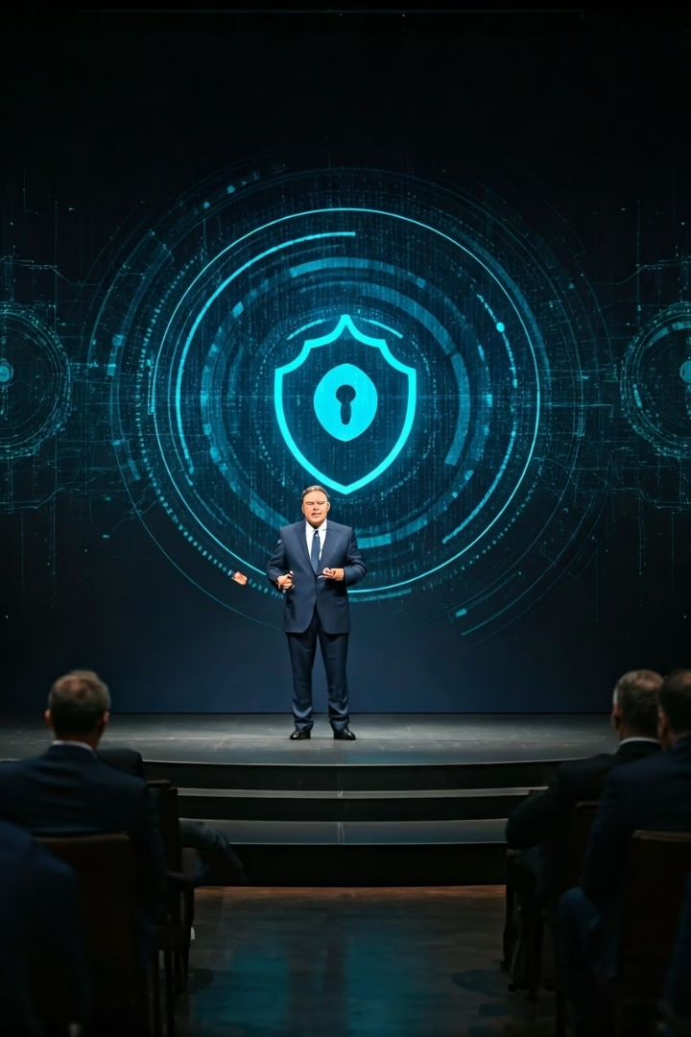
Call to Action for Leadership
Mandate a culture of data privacy
Require regular privacy audits emphasizing its importance at every organizational level – start with your own department to "lead by example"
Allocate resources
Invest in privacy-enhancing technologies and training initiatives to ensure your institution has the tools and knowledge needed for effective data protection
Regularly review and adapt policies
Stay ahead of evolving data privacy challenges by continuously updating your approach based on new threats and regulations
Partner with external experts
Collaborate with specialists for audits and to stay informed of best practices and legal developments in the rapidly changing privacy landscape
Vision statement: Let's position our institutions as national leaders in data privacy
Notes:
Inspire action by emphasizing the importance of leadership in creating a culture of privacy. End with a vision statement to position the institution as a leader in data privacy.
Thank the audience and reinforce the message that prioritizing data privacy ensures the longevity and trustworthiness of institutions.
Mandate a culture of data privacy by requiring regular privacy audits emphasizing its importance at every organizational level – start with your own department to “lead by example”
Allocate resources for privacy-enhancing technologies and training initiatives.
Regularly review and adapt policies to meet evolving data privacy challenges.
Partner with external experts for audits and to stay informed of best practices and legal developments.
Vision statement - Let’s position our institutions as national leaders in data privacy

