Slide 1

Data Center Relocation -
Do we still need a data center?
Randy Stubstad
Roanoke College
Data Center Relocation

Slide 2
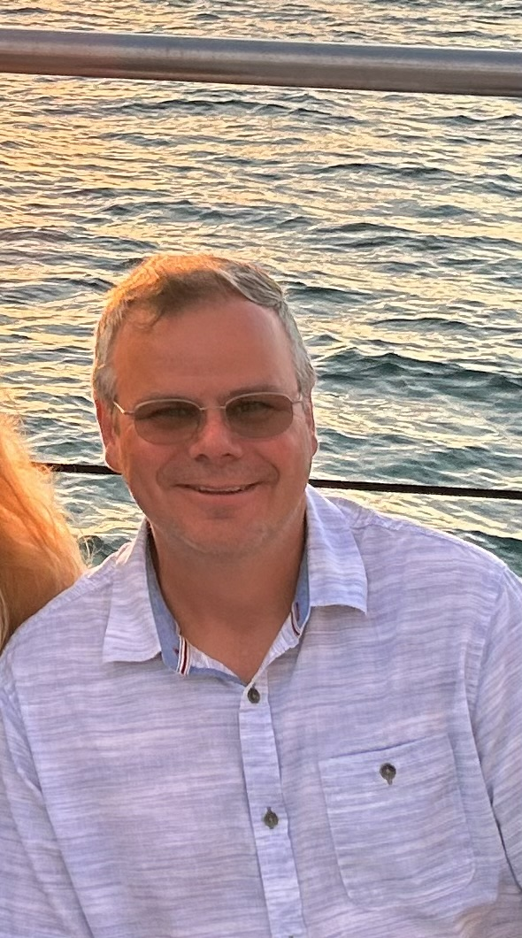
Randy Stubstad ’04
Associate CIO
18 years with Roanoke College
Data Center Relocation

Slide 3
Agenda:
Background
Project planning
Infrastructure setup
Migration phase
Post-migration tasks
Data Center Relocation

Slide 4
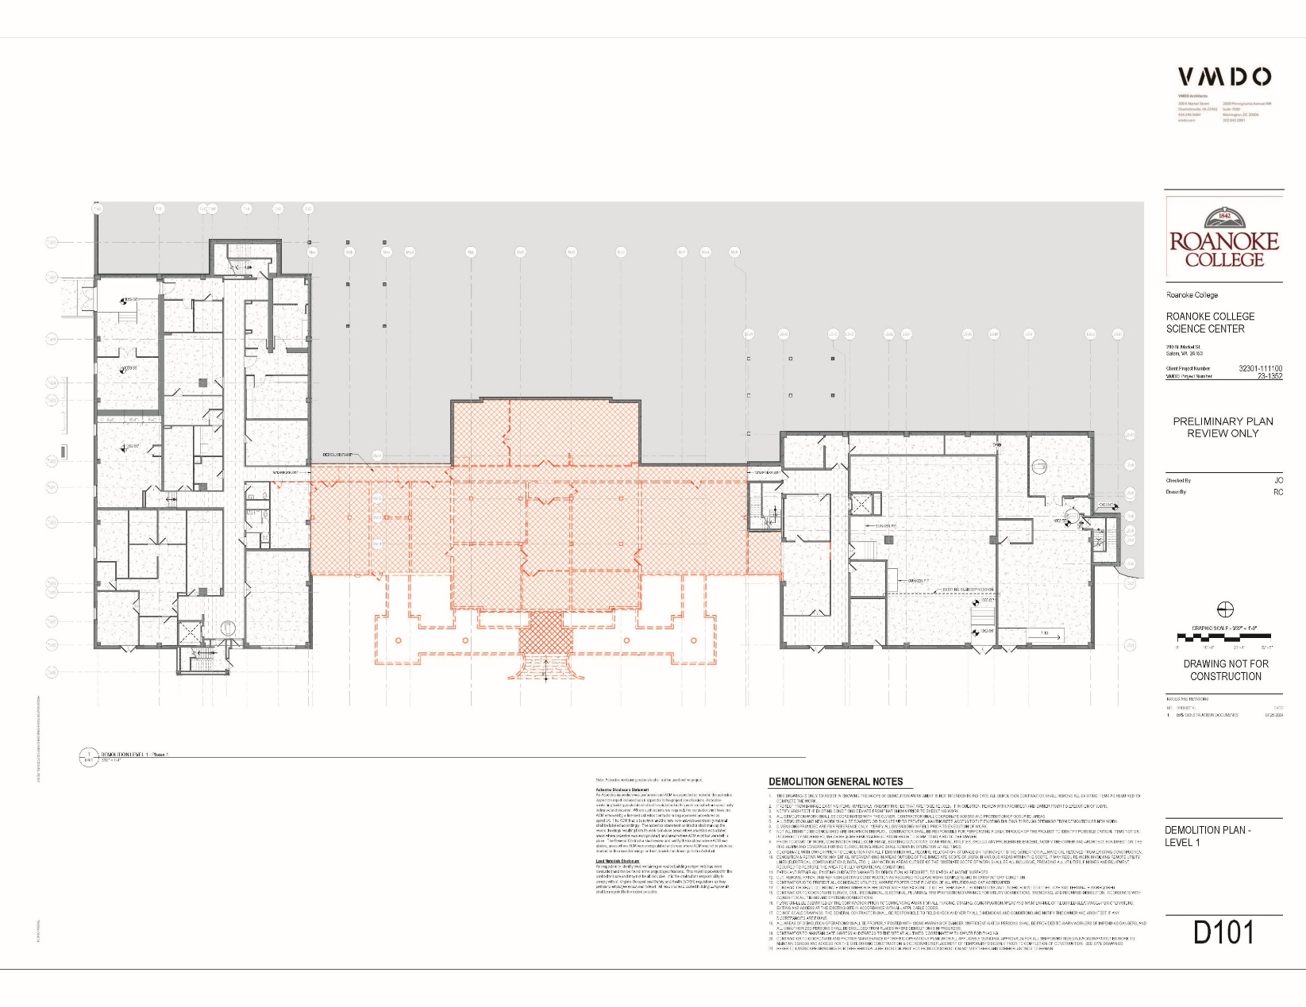
Background:
Data Center Relocation

Slide 5
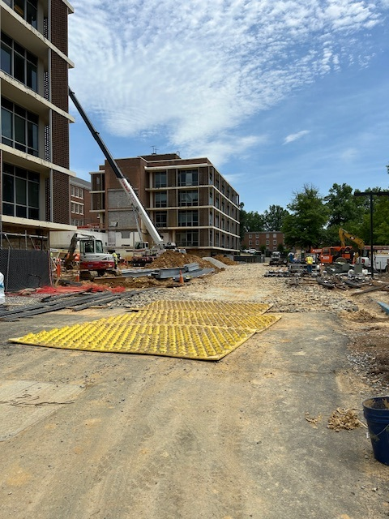
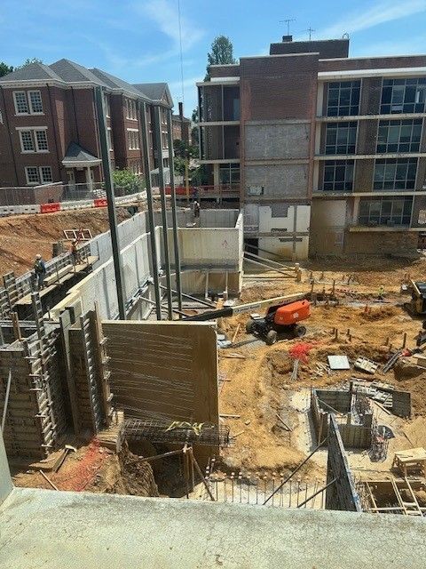
Background:
Data Center Relocation

Slide 6
Project planning:
Assess current infrastructure
Decisions and questions (do we still need one?)
Define scope and objectives
Develop a detailed project and communication plan
Establish timeline and milestones
Execution
Data Center Relocation

Slide 7
Assessment:
Network and server hardware | QTY | Description | Notes
Core switch | 1 | Cisco Catalyst 9600 serier 6 slot | Completed
FortiGate Firewalls | 2 | FG-2601F with 5 years FortiCare and FortiGuard | Completed
FortiAnalyzer | 1 | FortiGate log analyzer - 5-year VM license | Completed
FortiConverter | 1 | FortiCoverter - move config from old firewall to new | Sent PO 12/18/2023
Rack switches | 2 | Cisco Catalyst 9300 with NM, dual pwr supplies - 48 port | Completed
Fabric interconnects | 0 | UCS 6332-16UP (qty 2) | Considering UCS-X for fabric and blades - Cisco has huge discounts right now
Blade chassis | 0 | UCSB 5108-AC2 (qty 1) | Considering UCS-X for fabric and blades - Cisco has huge discounts right now
Blade servers | 0 | B200 M6 (qty 8) | Considering UCS-X for fabric and blades - Cisco has huge discounts right now
UCS-X | 1 | UCS-X config (Blades, Chassis and FIs all-in-one) | Install scheduled for May 28 and 29
Pure storage array | 1 | StaaS (approx $50K for 12 months - billed monthly) | Install scheduled for June 3rd - 10 am
Pure array move to new data center | 0 | Relocate and recert array | Negotiating - this is crazy
VMware licensing | 0 | ESXi licenses and vCenter - Call set up to discuss/seems high | Will use existing licenses - waiting on updated qoute
UPS | 1 | 30kVA UPS for new data center | Delivered
Data Center Relocation

Slide 8
Assessment:
Service provider moves | QTY | Description | Notes
Cable TV | 1 | Cost to move current system - downtime during move | Fiber work signed and scheduled, working on service contract
CATV transmitter | 1 | Add transmitter to replace 3 bad ones in the data center
Cox ISP | 1 | Cost to move (run in both data centers for a month or two) | Estimate from Cox
Segra ISP and IP phone system | 1 | Cost to relocate Segra phone system equipment to new DC | Estimate from Segra
Move Trane systems | 1 | Some equipment is on the back wall of current DC | Guess on costs
Move fire alarm system ring | 0 | Node on the ring - only system needing MM fiber now | Guess on costs
Move fire alarm system call box | 0 | Back right wall of data center | Guess on costs
Card access for Wortmann | 1 | Currently fed out of Massengil | Completed
Card access for Chalmers | 1 | Currently fed out of Massengil | Completed
Card access for Life Science | 1 | Currently fed out of Massengil | A-tech and Transact
Card access for Trexler doors | 1 | Add card access to new Trexler doors | A-tech and Transact
Analog to digital phone moves | QTY | Description | Notes
Red phones | 11 | Red phones to cellular | Completed
Elevator phones | 20 | Elevator phones to cellular | Completed
Panic button | 2 | Panic button to cell | Completed
Fire alarm phones | 1 | Fire alarm phones to cell | Completed
Replace fire alarm fiber ring with cellular | 0 | Convert fire alarms in each building to cell | Ben to lead - sent Ben list of buildings on fiber
Data Center Relocation

Slide 9
Assessment:
Data center equipment | QTY | Description | Notes
PDUs | 2 | 2 PDUs - 1 per each fiber rack | Ordered from CDW-G 5/14
IP KVM | 1 | For remote access | PO requested 4/25
Security cameras | 3 | Add camera coverage to new data center | Avigilon dome cameras
Env monitoring | 1 | Vertiv Geist with water sensors | Move existing
Cabinet blanks | 4 | Blanking panels for airflow | Randy's office
Tools and hardware | 1 | Misc supplies and tools for relocation | Wiremolding, blanking panels, cable management, cables
Cell extender? | 0 | Have spare - will use that one | Alex has spare
Cable TV tester | 0 | Tester for cable TV in buildings | Changing from coax to fiber between buildings
Fiber jumpers | 1 | Connect fiber boxes to switches | Have enough to start - will have better idea of what is needed once we start the move
SFPs | 1 | Connect fiber jumpers to switches | Have enough to start - will have better idea of what is needed once we start the move
Re-fiber campus | QTY | Description | Notes
Re-fiber Trexler side of campus | 1 | Re-terminating Life Science side and re-running Trexler side | Kegley estimate - Boring completed
Change to fiber for Trexler | 1 | Having to take the long way around for Trexler | Trench will not be ready in time.
3rd party support and assistance | QTY | Description | Notes
VMware assistance | 2 | Hours of support for VMware and UCS | SOW from 8/24/2023 - 1/2 at acceptance and 1/2 at completion
Cisco assistance | 20 | Hours of support for networking
Kegley assistance | 40 | Hours of support for cabling | Above and beyond the re-fiber of campus
Data Center Relocation

Slide 10
Decisions:
Decisions and questions
  Do we still need a data center, why don’t we just go to the cloud?
  Budget and time?
  Location?
  What stays and what goes?
  Racks, power, A/C, UPS, backup generator, fire suppression, etc.
Data Center Relocation

Slide 11
Scope and objectives:
Define scope and objectives
  OAC – Owner, Architect, Contractor – who is doing what?
  Smaller, more efficient footprint
  Minimal downtime to campus
    HA (high availability) – how do we use that to our advantage?
  Improved services and stability
  Evaluate equipment and replacements
Data Center Relocation

Slide 12
Project and communication plan:
Develop a detailed project and communication plan
  Establish calendars of events
    Fiber moves
    Major milestones
  Communication is key!
    Work calendars around campus events
    Work with offices as possible
  How to handle the “Oops” – have a plan
Data Center Relocation

Slide 13
Fiber calendar:
June 2024
SUNDAY | MONDAY | TUESDAY | WEDNESDAY | THURSDAY | FRIDAY | SATURDAY
26 | 27 | 28 | 29 | 30 | 31 | 1
2 | 3 | 4 | 5 | 6 | 7 | 8
 | Colket Center & Sutton Commons, Fox, and Yonce | Olin, Roselawn, Fowler House, Monterey, and Fintel Library | Miller, Lucas, Chesapeake, and Afton | Fintel Library
9 | 10 | 11 | 12 | 13 | 14 | 15
 | Catawba and Augusta | Wortmann Complex (Blue Ridge, Tabor, and Shenandoah) |  | Crawford, Smith, Bartlett and Marion
16 | 17 | 18 | 19 | 20 | 21 | 22
 | College Hall and Elizabeth Campus | Health Services, Chalmers, Annex, and Morehead | Holiday
23 | 24 | 25 | 26 | 27 | 28 | 29
 |  | Life Science | Campus Safety, Bank Building, Freshens, Ayres Hall and Shops
Data Center Relocation

Slide 14
Timeline calendar:
July 2024
SUNDAY | MONDAY | TUESDAY | WEDNESDAY | THURSDAY | FRIDAY | SATURDAY
30 | 1 | 2 | 3 | 4 | 5 | 6
 | A-Tech Trexler and Pi Lam doors, move Pure array | A-Tech Trexler and Pi Lam doors, move Pure array | A-Tech Trexler and Pi Lam doors, move Pure array | Holiday
7 | 8 | 9 | 10 | 11 | 12 | 13
 | A-Tech - Life Science doors, Power swap this week | A-Tech - Life Science doors, Power swap this week | A-Tech - Life Science doors, Power swap this week | A-Tech - Life Science doors, Power swap this week | A-Tech - Life Science doors, Power swap this week
14 | 15 | 16 | 17 | 18 | 19 | 20
 | Move servers, migrate off STaaS, fire alarm ring, Segra move | Move servers, migrate off STaaS, fire alarm ring, Segra move | Move servers, migrate off STaaS, fire alarm ring, Segra move | Move servers, migrate off STaaS, fire alarm ring, Segra move | Move servers, migrate off STaaS, fire alarm ring, Segra move
21 | 22 | 23 | 24 | 25 | 26 | 27
 | A-Tech - Cregger doors, CATV up, continue move and recycle | A-Tech - Cregger doors, CATV up, continue move and recycle | A-Tech - Cregger doors, CATV up, continue move and recycle | A-Tech - Cregger doors, CATV up, continue move and recycle | A-Tech - Cregger doors, CATV up, continue move and recycle
28 | 29 | 30 | 31 | 1 | 2 | 3
 | Clean-up and catch-up | Clean-up and catch-up | Clean-up and catch-up
4 | 5 | Notes
Data Center Relocation

Slide 15
Milestones:
Task | Start | Finish
Convert analog phone lines to cellular | In progress | 8/1/2024
Move Wortmann and Chamlers card access | Fall break | Completed
Start ordering equipment | In progress | 8/1/2024
Convert fiber fire alarm ring nodes to cellular | 9/1/2023 | 8/1/2024
New fiber conduit run | 10/16/2023 | Completed
New network switch setup and configuration | 1/8/2024 | 3/4/2024
New virtual environment setup and configuration | 1/8/2024 | 3/4/2024
Data center built and ready for us to start migration | 9/1/2023 | 5/17/2024
Run fiber between data centers | 5/1/2024 | 5/10/2024
Move new network core switch to new data center | 5/13/2024 | 5/17/2024
Move new virtual environment to new data center | 6/3/2024 | 6/14/2024
Move one ISP to new data center (Cox) | 5/27/2024 | 6/3/2024
Data center "virtually joined" | 5/13/2024 | 5/17/2024
Re-terminate buidling fiber | 5/20/2024 | 8/5/2024
Move second ISP to new data center (Segra) | 7/1/2024 | 7/26/2024
Move existing servers | 6/17/2024 | 8/1/2024
Move Trexler card access system control panel | 6/3/2024 | 8/1/2024
Install new card access control panel for Life Science and new data center | 6/3/2024 | 8/1/2024
Move CableTV to new data center | 6/24/2024 | 8/1/2024
Convert Cable TV to fiber between buildings | 6/24/2024 | 8/1/2024
Move existing networking equipment | 7/29/2024 | 8/1/2024
Data Center Relocation

Slide 16
Timeline:
Week | Description | POC
6-May | Branch finishing up and getting temp power | Branch
 | Get scope of rewiring data runs from MassTrex switch stack | Kluge/Alex
13-May | Racks, Cabinets and DC to DC fiber installed | Kegley Electric
 | Fiber pulled through new coduit for north side of campus | Kegley Electric
20-May | New core and firewalls installed and configured | Brad/Kluge
27-May | Cox ISP scheduled to move to new DC on Tuesday | Cox Business
 | ePlus scheduled for UCS-X install/configure (6/3 & 6/4 onsite) | ePlus
 | Fiber moves start | Kegley Electric
 | Fiber fire alarm system - call capabilities down | JCI
3-Jun | STaaS scheduled install (10 AM on 6/3) | Pure
 | CATV system taken down for the summer | Alex
10-Jun | ePlus here virtually to start virtual server migrations between the data centers | ePlus
17-Jun | Move CATV from old DC to new DC | Apogee
24-Jun | Install/Configure IP KVM | Jake
1-Jul | Complete move of all VM from old DC to new DC | Jake/Joel
 | Trexler door access install | A-Tech
8-Jul | Start moving physical servers from old DC to new DC | Jake/Brad/Joel
 | Move Pure array from old DC to new DC | Jake
 | Life Science door access install | A-Tech
15-Jul | Migrate VMs from STaaS to our Pure array | Jake/Joel
22-Jul | Remove and recycle all old servers and networking equipment from old DC | Jake/Joel/Kluge/Alex
 | Complete moving all physical server to new data center | Jake/Joel
29-Jul | Fiber moves complete | Kegley Electric
 | CATV up and running in all buildings | Alex
 | Fiber fire alarm system - call capabilities restored | JCI
5-Aug | Move 2 9606's from old DC to new DC | Brad/Kluge
Data Center Relocation

Slide 17
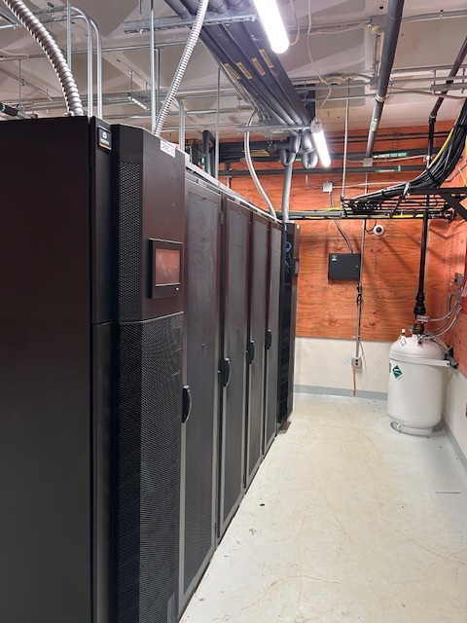
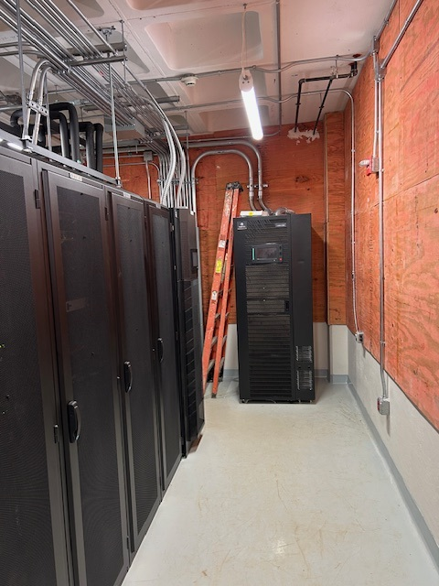
New Data Center:
Data Center Relocation

Slide 18
Execution:
Execution
  Expect adjustments to the plan
  “80% is operational” – sometimes that is the best you can do
  Pick your battles
  Keep pushing
    Keep to schedule as best as possible
    Don’t let the finishing touches get forgotten
Data Center Relocation

Slide 19
Questions?
Data Center Relocation

